Slide 1
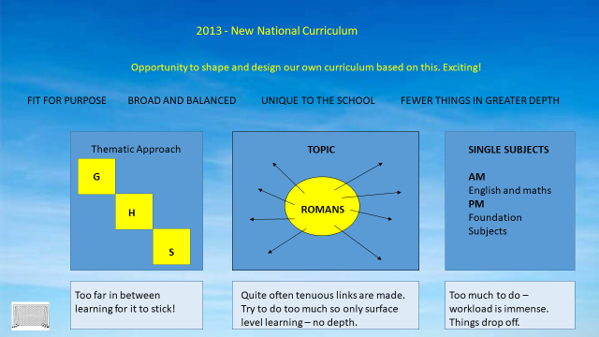

Slide 2
We began by looking at how Curriculum has looked over past 10 or so years and since the introduction of National Curriculum. The above slide shows the pitfall and positives of designs most common in England.
We discussed how in designing a new curriculum, which must be meticulously sequenced, that we can take the good elements from previous designs and weave them into a unique design of our own.
A real focus on fewer things in greater depth is a mantra for every strong curriculum. This does not mean we do less, but rather we look at how we sequence things and the time spent on them to ensure we are NOT trying to do too much all the time. The pitfall with model two on the previous slide.
We also understand that some lessons will stand on their own as we do not want to make tenuous links for the sake of it.
We are planning an inclusive and diverse curriculum where we have representation from all ethnic groups across the world, where disability is represented in literature and key people we study. It recognises and celebrates acceptance that people come from a range of different backgrounds and differ by age, gender, class, ethnicity, disability and faith.

Slide 3


Slide 4
One of the problems with the BIG questions previously asked was that:
Children struggled to make the connection between the learning and the question.
The children were not required to answer them – which led to them being quite meaningless.
They were placed onto an existing curriculum instead of the curriculum being designed around them.
LEADING questions are very different in our new CHALLENGE Curriculum.
They link to the national curriculum objectives – precisely.
The children know they will have to answer the question.
They are the starting point to many more research questions - allowing our children to think more deeply.
In answering the question during the piece of learning and at the end it informs teachers of how secure they are in their learning.

Slide 5
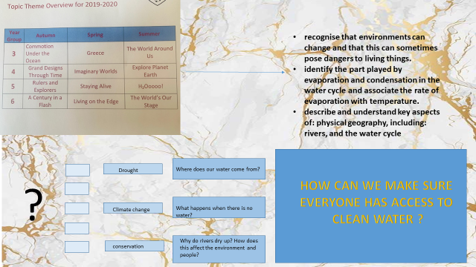
Where does our water
come from?
What are the effects of
water pollution
for our planet?
What is pollution?
What happens if food
chains are broken?

Slide 6
In the slide above you can see how a typical topic theme can be turned into a Leading question which links directly to national curriculum objectives and then further opens up the learning through more questions and then explores key concepts.
The children will be central to thinking more deeply about further questions – dependant on age and stage of learning.
They will also see the big picture of what they are doing and why – this is very important to any learner of any age.
We ask ourselves:
How can we challenge our children to think more deeply, to be opiniated and to know how to articulate this?

Slide 7

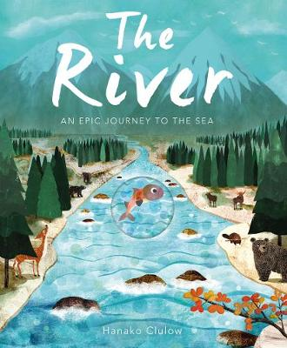
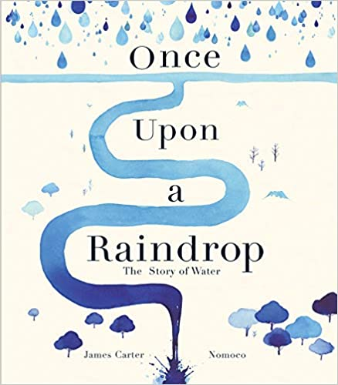
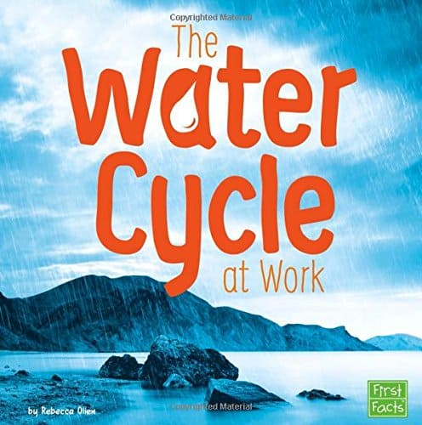



Slide 8
Reading is the beating heart of our Curriculum.
All key learning is linked to rich reading texts. We have invested heavily into leading and supporting literature which will be unpicked during whole class teaching of reading (WCTR) and throughout the week.

Slide 9


Slide 10

Fewer things in greater depth
Interconnectiveness

Slide 11

Deep and meaningful connections across the curriculum.
Children can see the big picture of what they are doing and why.
Know more, remember more and can do more.
If we want children to have a deep and secure understanding – we have to be specific and lean.

Slide 12
Curriculum INTENT
The school continues to undergo necessary changes to ensure they are constructing an inclusive curriculum that is highly ambitious. Focusing on fewer things in greater depth, meticulous sequencing to secure cumulatively sufficiently knowledge for children’s next stage of learning. Both broad and balanced, the school advocates that “Reading” is the beating heart of the curriculum and the gateway to the whole school curriculum. The new “Naunton Park CHALLENGE Curriculum” is designed to help children know more and remember more, where design is centred upon key concepts which allow children to make connection between larger ideas as they move throughout their education. It is also our intent that, through our multifaceted curriculum, married with high expectations around conduct, our children leave us as caring, respectful and acceptant young people prepared for life in modern Britain and Key Stage 3.
Naunton Park’s CHALLENGE Curriculum aims to provide our children with a great education, to develop a love of learning and the capacity to make a difference in their lives. At our core is a belief in gaining depth of knowledge, in work that is challenging: both experiential and enquiry led and producing quality work. Our curriculum is not just about what we put in but is also concerned with what we draw out, encouraging children to think deeply about complex issues and achieve great things in a great way.
Focusing on fewer things in greater depth, our unique design enables quality work on key concepts, deepening children’s understanding over time. Learning is also anchored in valuable key experiences, imparting new knowledge. We focus on developing the learner as an individual, to be curious, independent, resilient, resourceful and thoughtful.
Pieces of learning are enquiry led providing children with opportunities to demonstrate and represent their learning in different ways. It is centred upon carefully selected leading and supporting literature which is being mapped out from EYFS to Year Six. There is a love of reading in our curriculum and throughout the school, in both reading for pleasure and reading for knowledge.

Slide 13
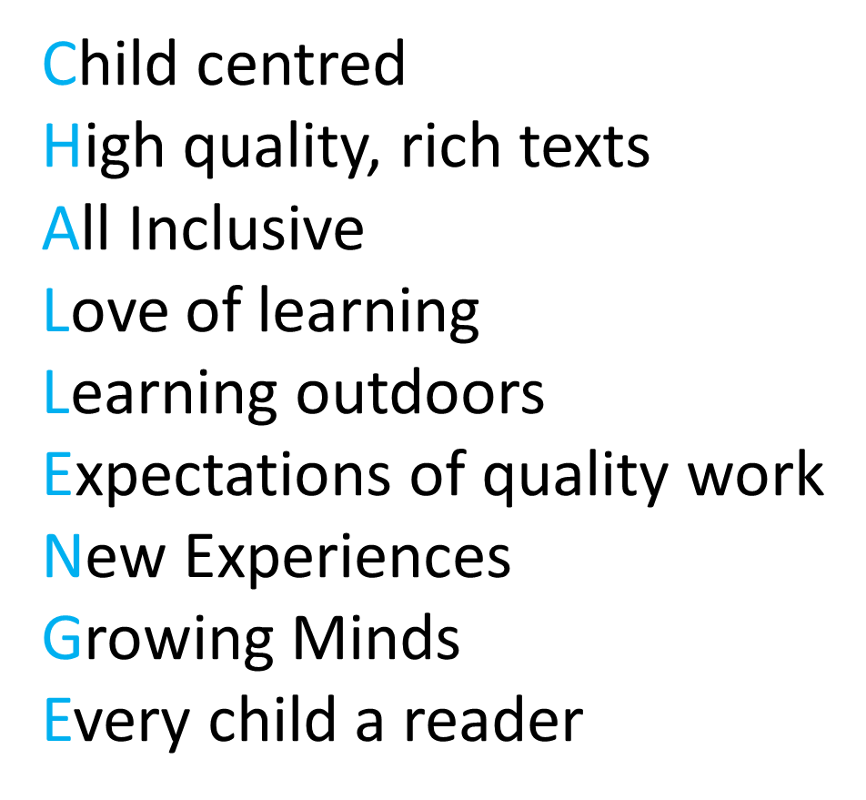

Slide 14
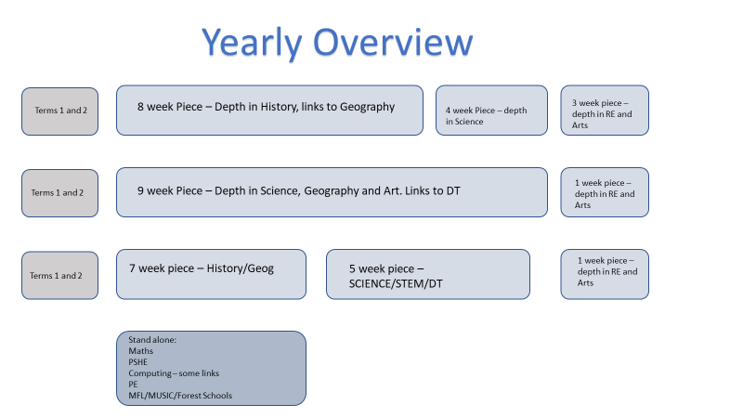

Slide 15
In the slide above you can see how the new curriculum is designed over a series of pieces of learning: each with their leading question. At the moment you can go to the school website to see this terms learning as an overview. You will also see other pieces of learning that are in draft as work together to design the rest. This is a huge piece of work which will last until December 2023, then we will review a whole academic year to see what has gone well and what we can further improve. A school's curriculum is never completed, it is always reviewed, new literature may be added, and we may change leading questions.

Slide 16
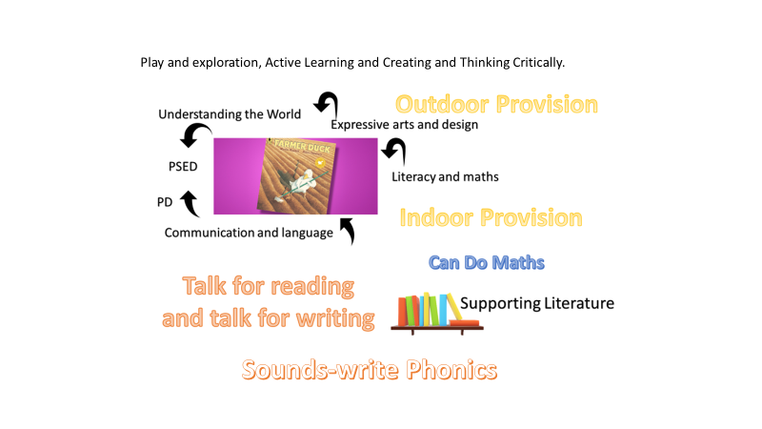

Slide 17
Above is the overview map for Early Years ( Reception class)
In reception they will not have a leading question as questions and challenge will be threaded through their curriculum constantly. Each short term the learning will be led by leading literature and will be led by the children.
We will have another meeting this term to fully explain the Early Challenge Curriculum.

Slide 18
Our Wonderful World,
Our Wonderful Town.
Year Five – Leading Question
To what extent has human activity affected our biomes?
*describe the differences in the life cycles of a mammal, an amphibian, an insect and a bird * describe the life process of reproduction in some plants and animals.
Science
Build upon knowledge of cycles
Go deeper: difference in life cycles of a mammal, amphibian, insects, birds. Life processes/ reproduction in plants and animals.
Build upon - previous geographical enquires.
Exploring Biomes around the world
What affects them – tourism, urbanisation, deforestation, agriculture, over population.
Geography
physical geography, including: climate zones, biomes and vegetation belts
human geography, including: types of settlement and land use, economic activity including trade links, and the distribution of natural resources including energy, food, minerals and water
▪ understand geographical similarities and differences through the study of human and physical geography of a region of the United Kingdom, a region in a European country, and a region within North or South America
Leading Literature and reading
Class Readers: The Keeper – Mal Peets
WCTR: The wonder garden – Jenny Broom. What is a biome – Bobbie Kalman. Saving species – Jess French. Disappearing Acts – Isabella Bunnell. Last tree in the City.
Fiction: T4W – Suspense
Non-Fiction: T4W – Inform and Explain
Writing
Recycled Art and Conscious Art
Nature Focus and environment stimulus – choose biome.
Researching artists who use recycled materials
ART
*to use a range of materials creatively to design and make products
*to develop a wide range of art and design techniques in using colour, pattern, texture, line, shape, form and space
DT/Cooking
A vegetarian Diet – Visit or visitors with vegetarian recipes.

Slide 19
Year Five – Leading Question
To what extent has human activity affected our biomes?
Picture Books
Trees and deforestation – Carol Sutters
Here we are – notes for living on planet Earth – Oliver Jeffers
What We'll build, plans for our together future.
Synopsis
Through this piece of learning children will learn what a biome is and explore the different Biomes in our planet. They will learn in depth about the 4 main biomes and the life that inhabits them. Children will learn about the life cyclers of plants and animal in these very different Biomes and the reproduction of animal too.
They will learn and think deeply about the delicate balance of nature within the biomes and then how our human activity can compromise and impact harmfully on the nature within them.
Children will look at the effects of tourism, urbanisation, deforestation, agriculture and over populations. More importantly they will look at how we can reverse the damage caused through this activity.
In doing this they will also strengthen their skills in geographical enquiry and locational/place knowledge.

Slide 20
Science / Geography / ART
Term 3 and 4
Week 1-10 |  |  |  |  |  | Week 11
 | Session 1 | Session 2 | Session 3 | Session 4 | Session 5 | all week – maths+
Mon | WCTR | Maths | English C/C | PE | Comp. | RE
Tue | WCTR | Maths | English C/C | C/C | C/C | RE
Wed | WCTR | Maths | English C/C | C/C | C/C | RE
Thur | WCTR | Maths | English C/C | PSHE | C/C Forest school 8 weeks For each class. | RE
FRi | WCTR | Maths | English C/C | Music/MFL | PE | RE

Slide 21
The previous two slides are an example of teacher's initial overviews, from this they will then complete milestone planning which will be available on the website soon.
You will also receive plans for home from the teachers.
The timetable is a sample of how the C/C cross curricular subjects are ordered in a week. By focusing on fewer things in greater depth and blocking out certain subjects through pieces of learning we have freed up more time for foundation subjects.
Also the WCTR is based on the leading literature so geography/history (for example) knowledge is being imparted here too.
A class reader will also be part of the 30 minutes WCTR sessions.
Just read will happen 12 weeks every year, starting in September.

