Slide 1
Sounds-Write and Early Reading

Slide 2
Sounds-Write
Sounds Write is a linguistic phonics programme – based on speech (think sounds first) and is based on whole words
Very structured
Different to how we have previously taught phonics
30 minutes every day (in KS1) with about 3 different activities within that 1 lesson (including either reading or dictation)

Slide 3
Sounds-Write 3 key skills
blending
segmenting
phoneme manipulation

Slide 4
Sounds-Write conceptual knowledge
letters are symbols (spellings) that represent sounds
a sound may be spelled by 1,2,3, or 4 letters
the same sound can be spelled in more than one way
many spellings can represent more than one sound
letters represent sounds not make sounds

Slide 5
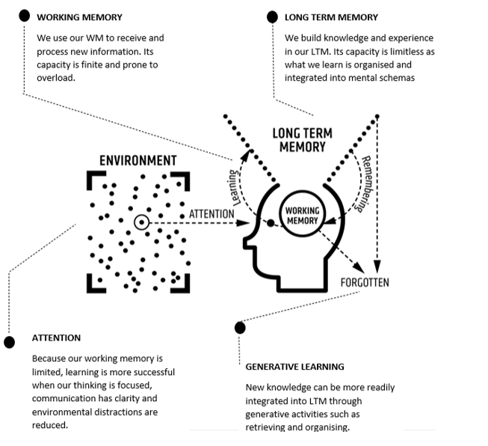
A simple model for how memory works is based on the concept of building schemata in our long-term memory.
Schema is a mental structure to help us understand how things work. It has to do with how we organize knowledge. As we take in new information, we connect it to other things we know, believe, or have experienced.

Slide 6
3 parts Sounds-Write lessons
review prior learning (previous unit)
new learning (current unit)
retrieval - reading and writing in connected text

Slide 7
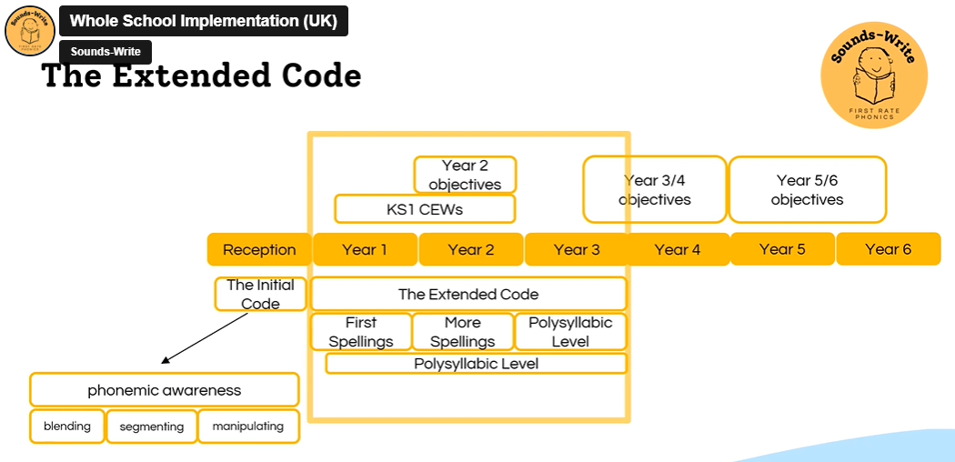

Slide 8
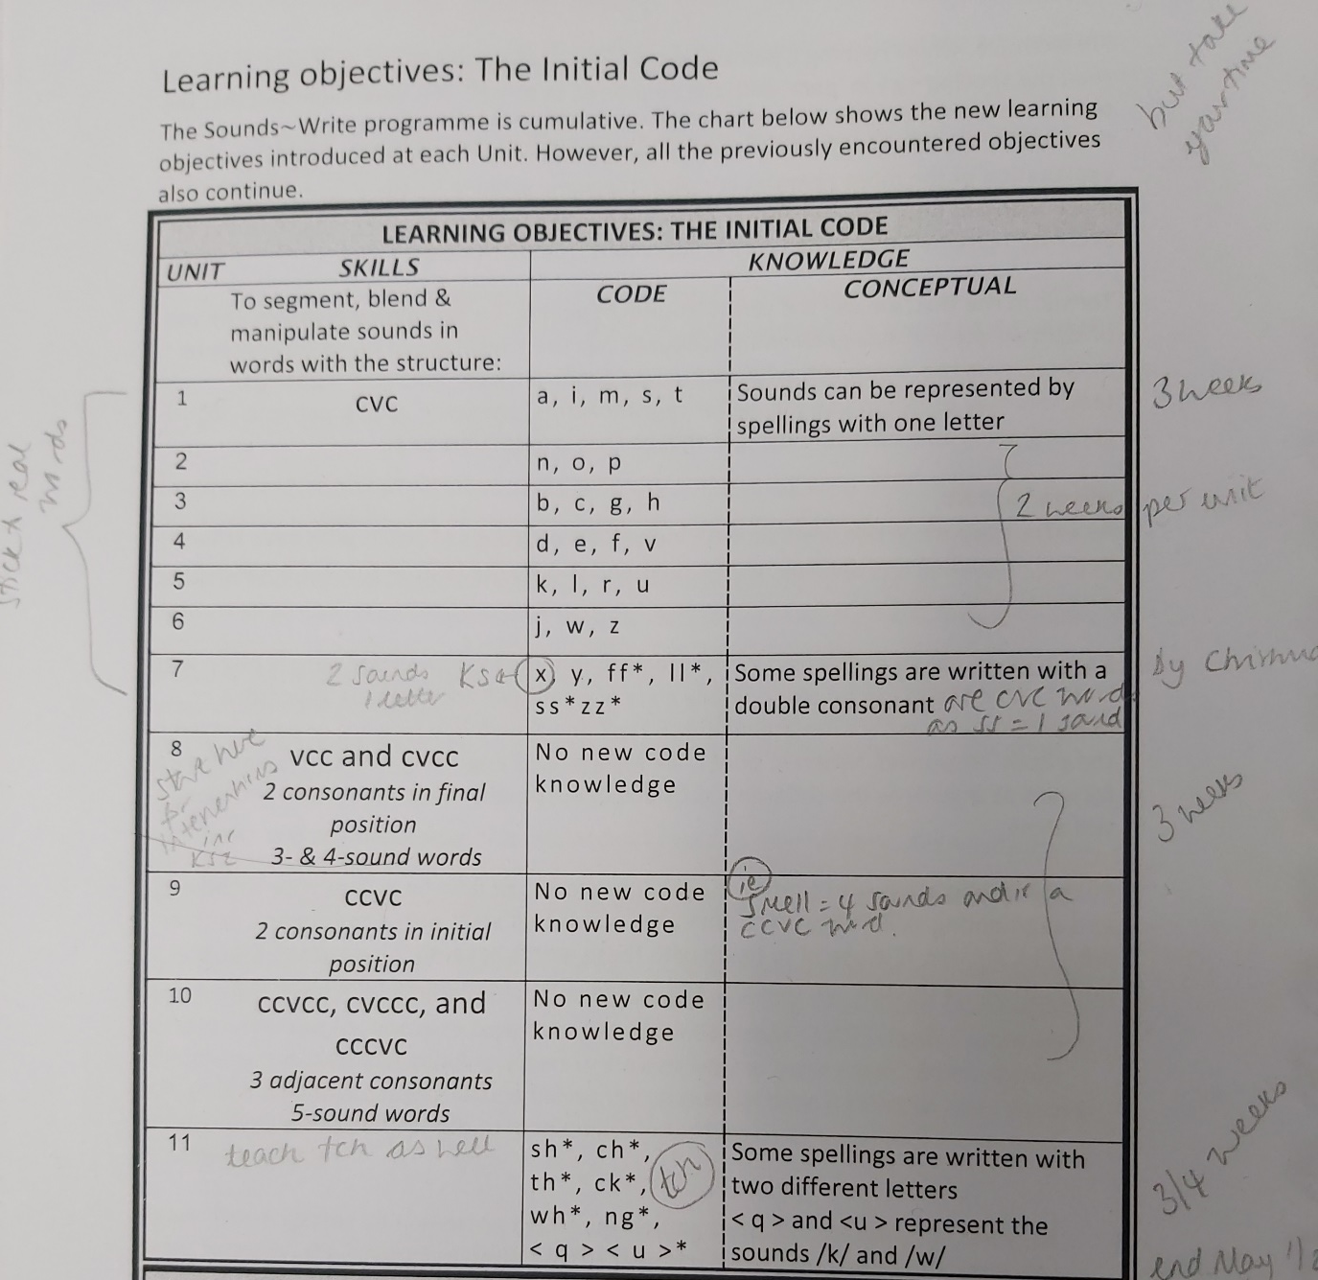
EYFS
starts with the Initial Code
everybody is part of the daily lesson
starts with word building by saying the whole word
much bigger focus on segmenting, blending and phoneme manipulation skills so that this is solid before moving onto 2 letters representing 1 sound (digraphs)

Slide 9
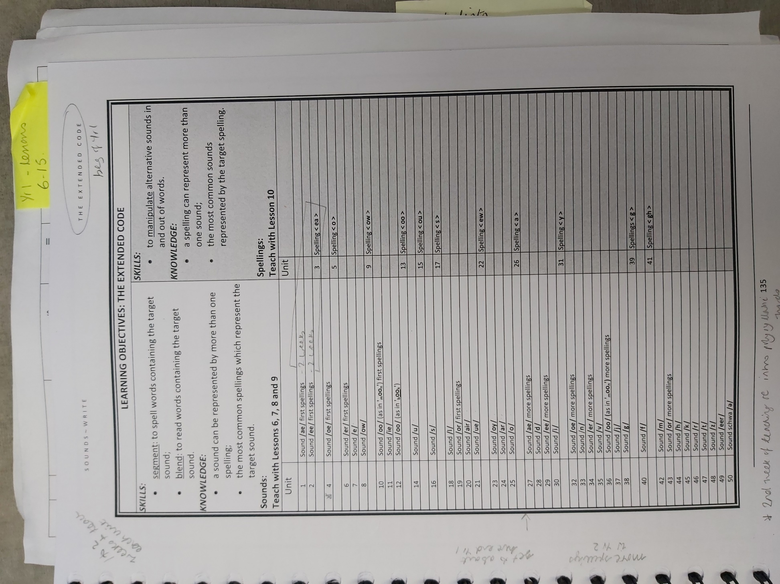
Year 1
starts with Extended Code
same sound, 4 different ways to spell that sound (including split spellings)
one spelling, different sounds <ea>
polysyllabic words

Slide 10
Year 2
still Extended Code – revisit with more spellings
same sound, different ways to spell that sound (including split spellings)
Year 1 /ae/ <ai> <ay> <ea> <a-e>
Year 2 /ae/ Year 1 plus <a> <ei> <ey> <eigh>
one spelling, different sounds <ea>
polysyllabic words

Slide 11
Years 3 to 6 (moves from phonics to spelling focus from Year 4)
revisit Extended Code at a polysyllabic level (estimated that more than 80% of the words in the English language are polysyllabic).
polysyllabic – break words down into their syllables to spell them
batman bat/man
hidden hid/den
decide de/cide
experience ex/pe/ri/ence
spell National Curriculum statutory words
Years 5 and 6
prefixes, suffixes and morphology of words

Slide 13
Changes to be aware of
Tricky words/HFW refer to them as having one of the more unusual spelling patterns (said, he, was)
‘curly c’ and ‘kicking k’ – we model on a whiteboard or piece of paper that in this word the c sound is represented with this letter (all about referring back to the sound)
Magic e/ split digraphs – now called split spellings, when we read a word with a split spelling of /ae/ we say /ae/ sound when we see the first part of it in the word.
If you are asking a child to read words or spell words as a recap to practise a sound, you should always give them words that you have already worked on. Make sure you choose the words so that they fit.

Slide 14
Supporting teachers and children during Sounds-Write lessons: error corrections
Pure sounds – be aware of muh, luh, nuh and correct! Tell them that is 2 sounds /m/ and /uh/ Point to your mouth and tell the pupil “say it like me”
Letter names – if they say a letter name. “That is the letter name. We want the sound. Listen again (say the whole word). What’s the first sound in sssssssssat?”
Make sure that they don’t say 2 letters as one sound if that isn’t right. Eg: swim as ‘sw’. Stretch out the word, draw right number of lines on their whiteboard so that they can see how many sounds there are. “What sound can you hear when my finger is here?”
When spelling and they choose the wrong spelling – Point to the correct spelling or write it on their whiteboard “This is the way we spell /s/.” or “yes, that spelling does represent the /ae/ sound but in this word we spell it this way. “ Model it for them. Make sure they re-write it too.
When spelling they miss out a sound – “if we are writing swim, which sound would be here?” Then ask them to rub out the word up to the correct part and re-write.
Writing a letter wrong way round – model on whiteboard. “This is the way we write a /p/.” Good practise to get them to write the whole word again.
Reading words – adding or leaving out sounds “If this were slip, there would be an /l/ here. Is there another sound? Say the sounds, read the word.”
Spelling help – ask them which part of the spelling they are finding tricky so that we don’t give them the whole word but support with what they need.

Slide 15
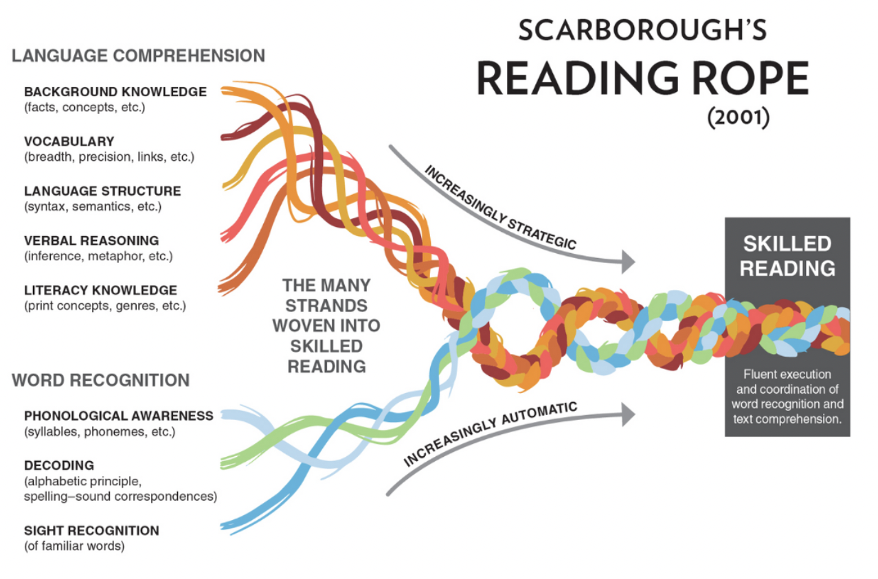
The process of early reading
Decoding – this is where they segment and blend to decode a word.
Fluency – this is when they can read words without needing to decode. They need to re-read texts to develop fluency.
Reading comprehension

Slide 16
Early reading
Decoding – this is where they segment and blend to decode a word. This can be exhausting and frustrating for children learning to read.
Little and often
Practise key sounds that you know they find tricky and are going to come up in their book. Remember sound first. Put flashcards on table. Which of these represents the <v> sound? Can they find it ? If not, tell them. This is the <v> sound.
Read a sentence encouraging them to segment and blend.
Help them (don’t make it into a test!).
Blending – is usually the trickiest part. See blending blog notes on what to do.
Do get them to re-read the sentence again. To help develop fluency. And again… if they are still happy to!
If they have read it with fluency, you could do a little bit of reading comprehension.
Learning to read turns into reading to learn!

Slide 17
Reading books
Sounds-write books are functional – chance to practise blending, segmenting decoding skills. Usually 2 or more units below what we are working on in our Sounds-Write lessons.
Some children who are fluent readers will also take home a levelled reading band book.
All KS1 children are also taking home a library book to have an adult at home read to them for ‘richer read’ and to develop language comprehension skills.
KS2 children
OUP books in the KS2 library
Dandelion books (KS1 library)
Barrington Stokes books (Katie’s room?)
Please come and ask if you need any other books.
Teachers should be aware of what level children are reading at!

Slide 18
Next steps
Please use what we have talked about today to support children during whole class Sounds-Write lessons.
All children should be in the class for the whole class Sounds-Write lesson.
Focus on those children who are lowest 20% readers and writers.
Eva (EAL), Bonnie and Lyndsey will have S-W intervention groups.
Class S-W intervention groups – training to be organised.
All children working below expected/secure levels should have a S-W diagnostic assessment completed (Eva, Bonnie, Lyndsey and Louise can do these).

Slide 19
THANK YOU

