Slide 1

Year 1 Phonics and Reading Information

Slide 2
Aims of this Power Point.
To inform you:
How is Year 1 different to Reception ?
What we mean by ‘phonics’
How we teach phonics at Naunton Park
About the Y1 phonics screen in June
We will also suggest ways to help your child at home and remind you some of the resources that have been coming home.

Slide 3
What are phonics?
The dictionary definition is
A method of teaching people to read by correlating sounds with letters or groups of letters in an alphabetic writing system.
English only has around 44 phonemes but there are around 120 graphemes or ways of writing down those 44 phonemes. Obviously we only have 26 letters in the alphabet so some graphemes are made up from more than one letter.

Slide 4
Phonics teaching at Naunton Park
Children are taught phonics daily. The teaching progression is in phases as follows:
Initial letter sounds - a,b,c (phase 2)
Sounds that are written using two letters (digraphs) such as sh, ch, th and ee, ou, (phase 3)
Sounds written with three letters (trigraphs) eg ure, air, (phase 3)
Split digraphs (magic e) a-e, e-e, i-e.... (phase 5)
Alternative spelling patterns for a sound – ee/ea/y (phase 5)

Slide 5
- We teach them to recognise the phoneme (sound) that each grapheme (letter or letters) makes.
Children progress through 6 phases in phonics from Reception to Year 2.
Phonics sessions are daily, about 20 minutes long and include phonic games, reading and writing letters and sounds. It includes learning ‘tricky words’ – those which can’t be sounded out.

Slide 6
So what is blending?
Blending is the skill of putting together more than one individual sound to make a new sound.
Children are taught the most common phonemes (or sounds) i.e. ch, sh, th, ai, ou, ee, etc, but the skill of combining letters and sounds to read words is called blending.

Slide 7
OK, so give me an example.
The sounds in these words need to be blended together to enable the words to be read easily.
black b l a ck
cling c l i ng
drip d r i p
lift l i f t

Slide 8
split digraphs or the magic ‘e’.
There are 5 split digraphs: a-e, o-e, u-e, i-e, e-e or you might remember them as the Magic ‘e’.
Some of our children have difficulty spotting this.
When reading, point out split digraphs and discuss how to blend them together.

Slide 9

gave
dive
late
vote
nice
mute
home
The ‘magic e’ casts a spell to make the vowel in the word say its name...then it disappears!
home
home

Slide 10
Other strategies...that are equally important
Using picture cues
Making sense of what they are reading (reading for meaning) Do they self correct when they get a word wrong?
Sight vocabulary of common exception words eg the, said, come, he

Slide 11
Phonics resources to use at home

Slide 12
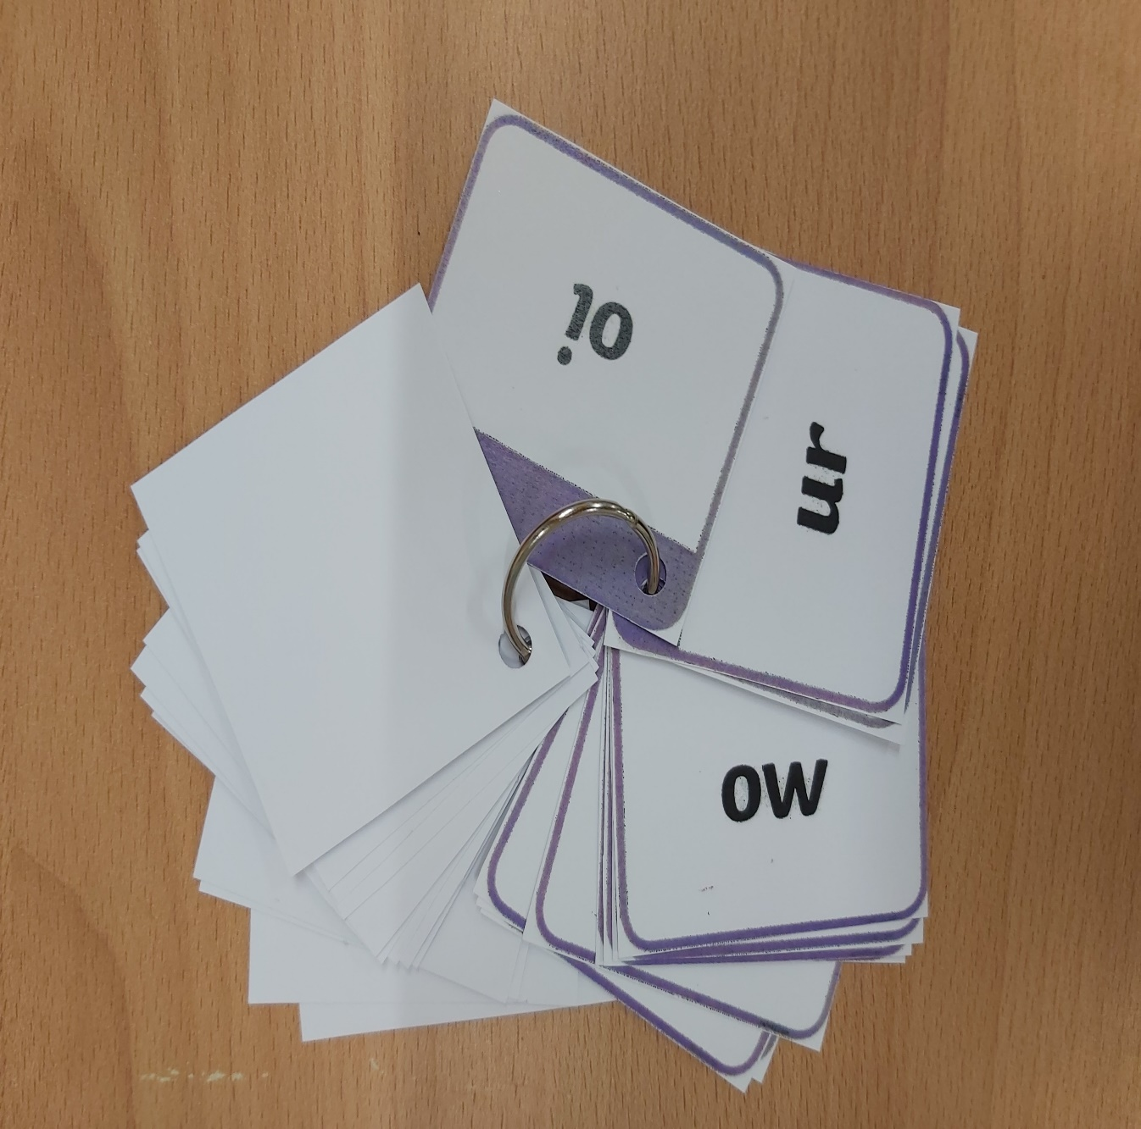
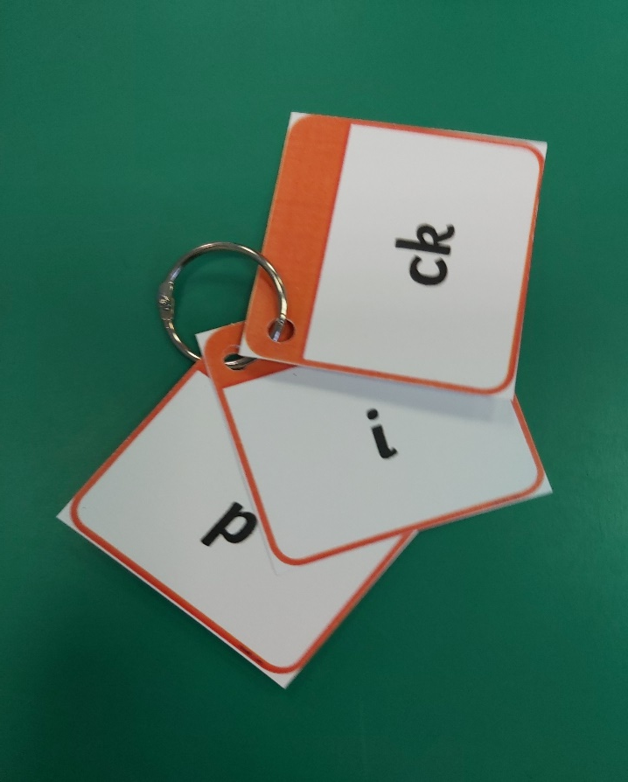
Following on from Reception, we will send home flashcards to match the phonic phase they are working on in school along with a new set of tricky words to learn off by sight.
Phonic sounds flashcards so that you can practise those tricky ones at home.

Slide 13
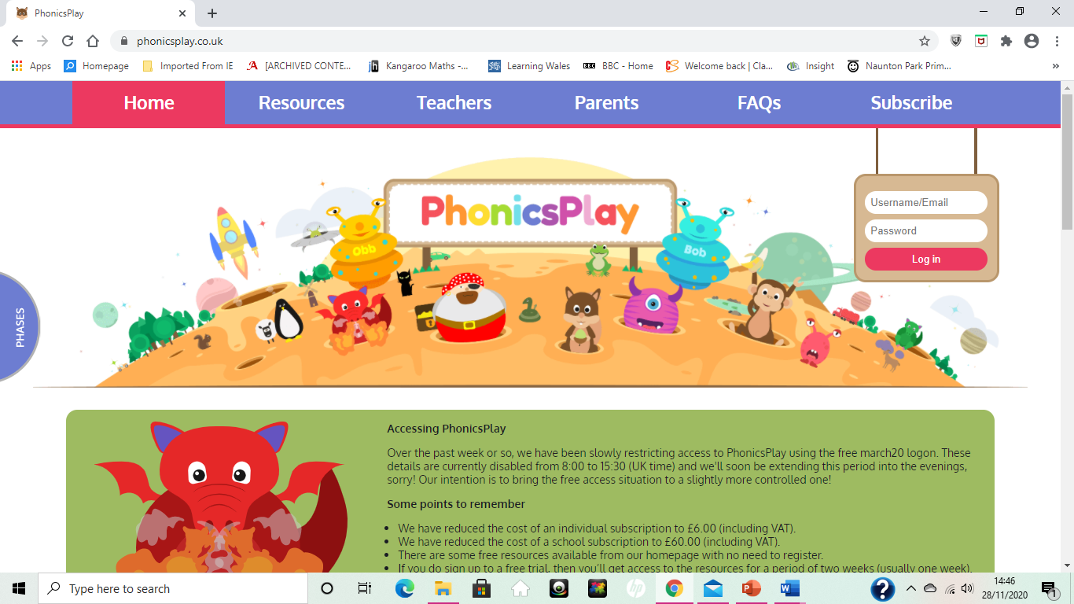
This is the website that we use all the time with the children. Some of its activities are free but there is also a subscription needed to access some additional games.
www.phonicsplay.co.uk

Slide 14
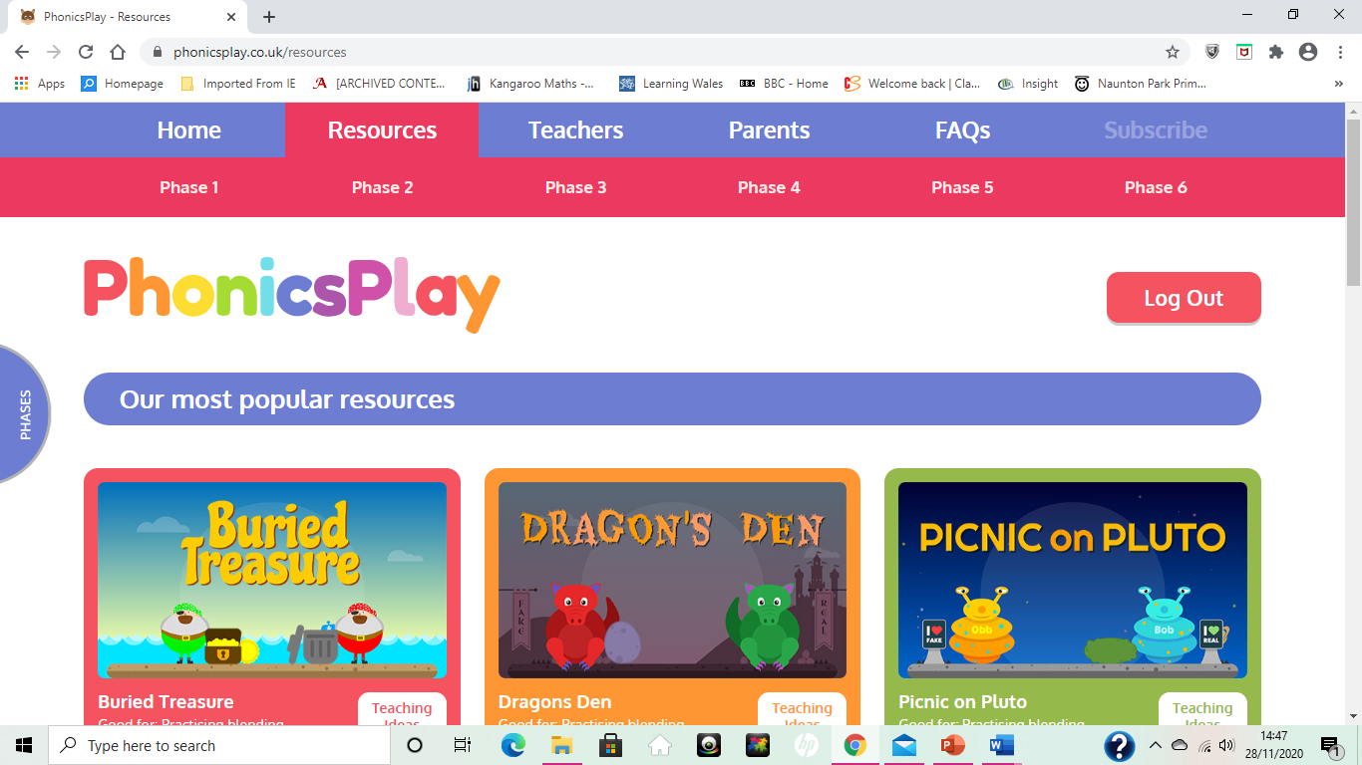
Just choose the relevant phase from the tabs along the top.

Slide 15
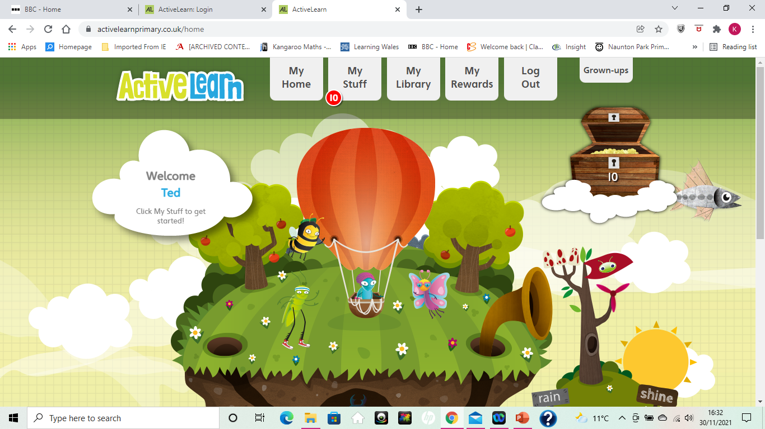
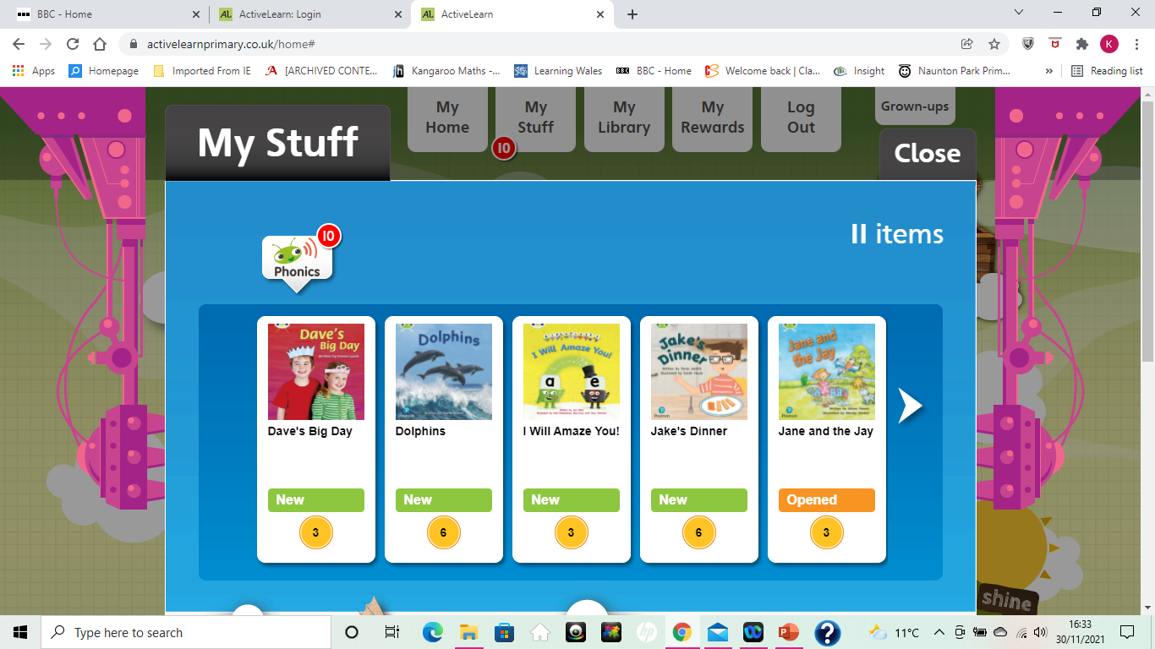
Bug Club
https://www.activelearnprimary.co.uk/login?c=0&l=0
You can read books online that match the book band colour you are reading at school.

Slide 16
Phonics you tube suggestions and websites
This is a great website for ideas for games that you can play to practise phonic sounds that your child might find tricky.
https://phonicsfamilycom.wordpress.com/
Twinkl TV you tube site – these are short 5 minute films explaining digraphs and providing some reading practise. Just search for the digraph you want your child to work on.
https://www.youtube.com/watch?v=K0hU2G_1zDs phase 3
https://www.youtube.com/watch?v=jCarcTCR840 phase 5
https://www.youtube.com/watch?v=Iy4BNQg4pYE this is a very useful film that explains phase 5 split digraphs to adults!
Mr Thorne does phonics – these are also short films explaining digraphs. Just search for the digraph you want to focus on.
https://www.youtube.com/watch?v=IRTITdRL_cU

Slide 17
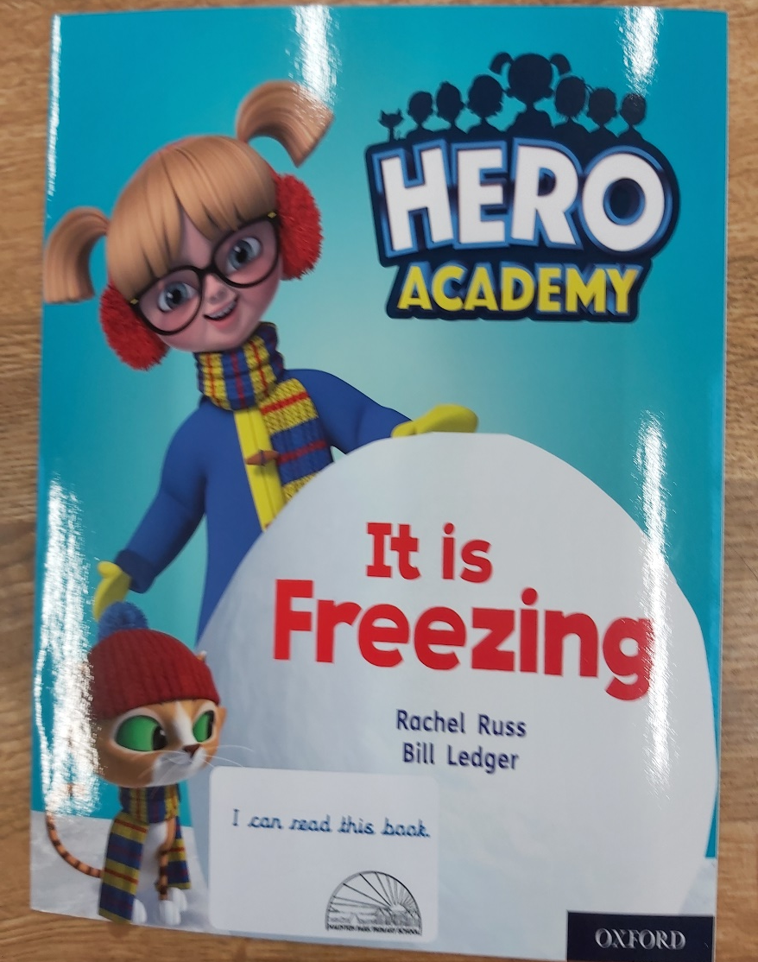
School reading books
If your child is reading from the pink through to orange book band levels, they will bring home 2 school reading books each week.
One will have a label with blue writing on the front. I can read this book.
This is a book for your child to read to you and it is matched to the phonic phase they are currently working on in the classroom. The words can either all be sounded out and then blended to work out the word, or have high frequency or tricky words that they have been practising from their phase word mats / flashcards. We expect them to read this book with you several times during the week so that they become more confident and fluent at reading.

Slide 18
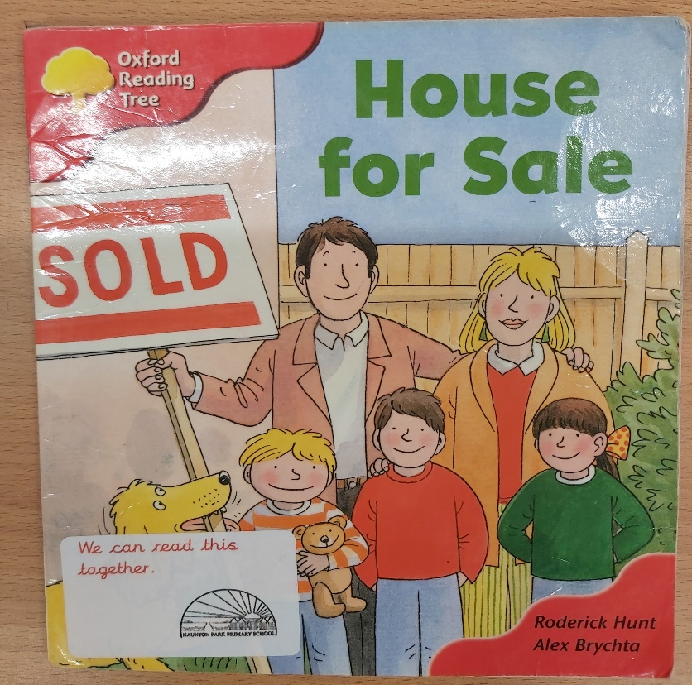
The second book will have a label with red writing on the front saying:
We will read it together.
This book is from the same coloured book band as their other book but will have some trickier high frequency words or contain phonic sounds that they might not have learnt about yet. We would like you to share this book together, helping your child to work out the words they find tricky and talking about what is happening in the story to work on their reading comprehension skills. This is a ‘richer read book’ and is to be read for pleasure.

Slide 19
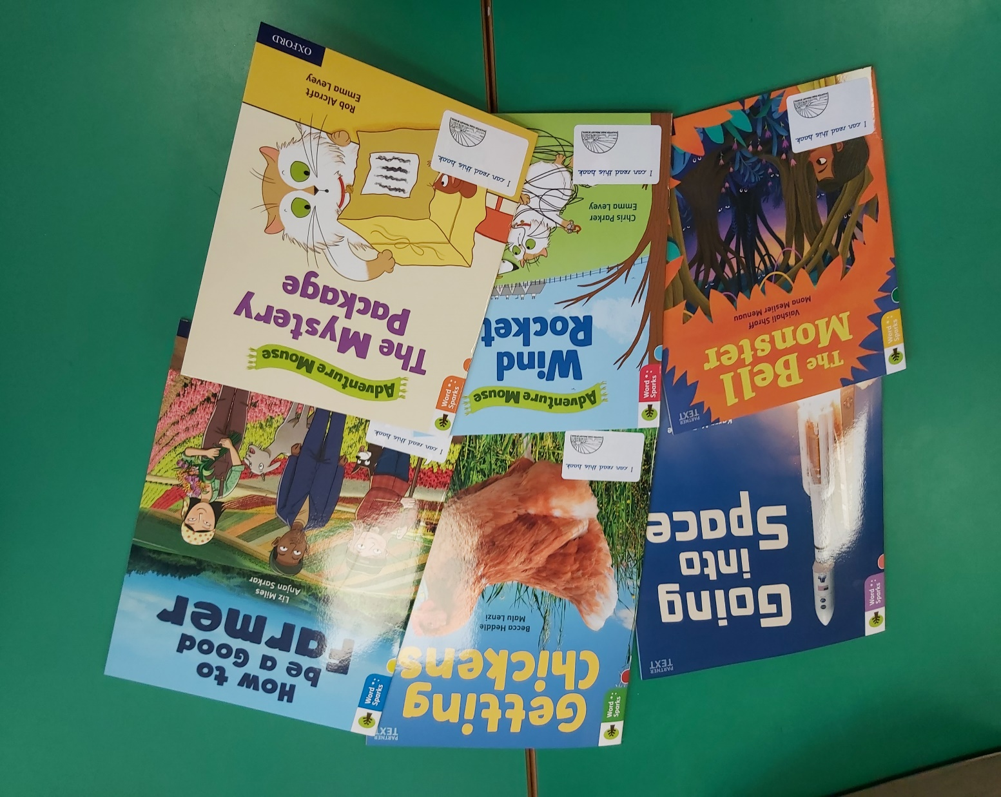
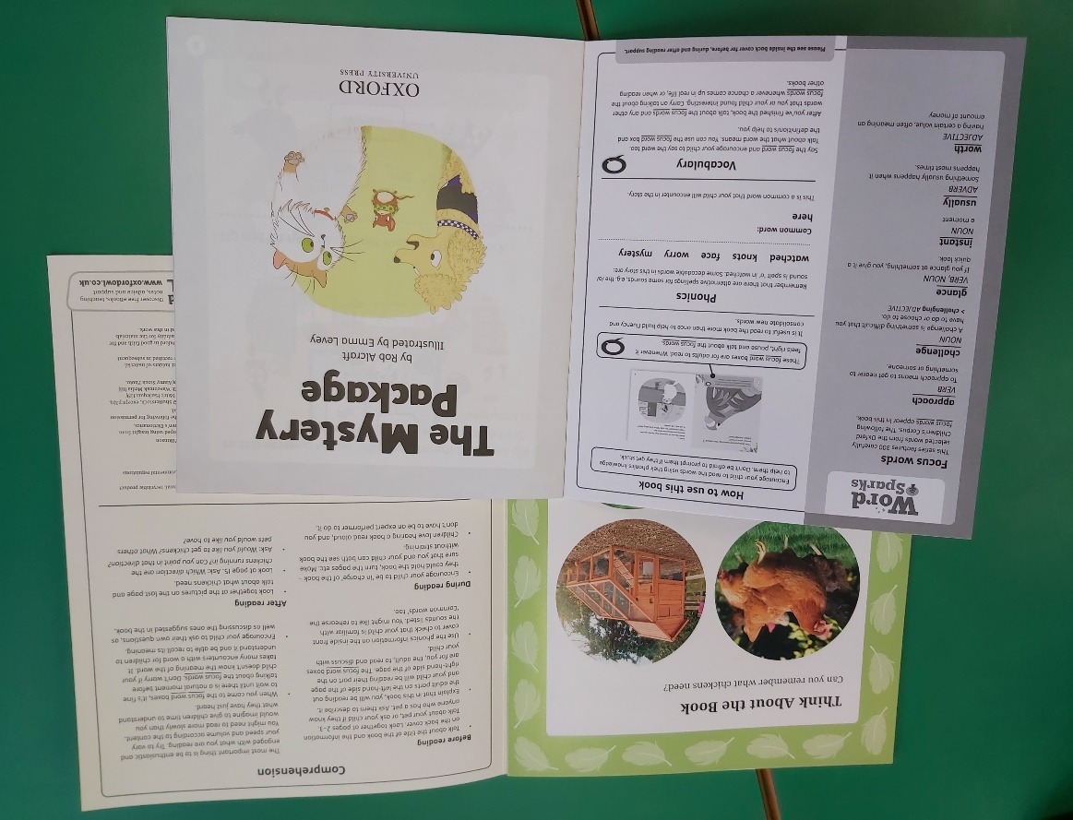
We have invested £4,000 in new reading books for KS1 since March 2020.
The new books have very useful tips on how to support your child while reading these books inside the front and back covers.

Slide 20
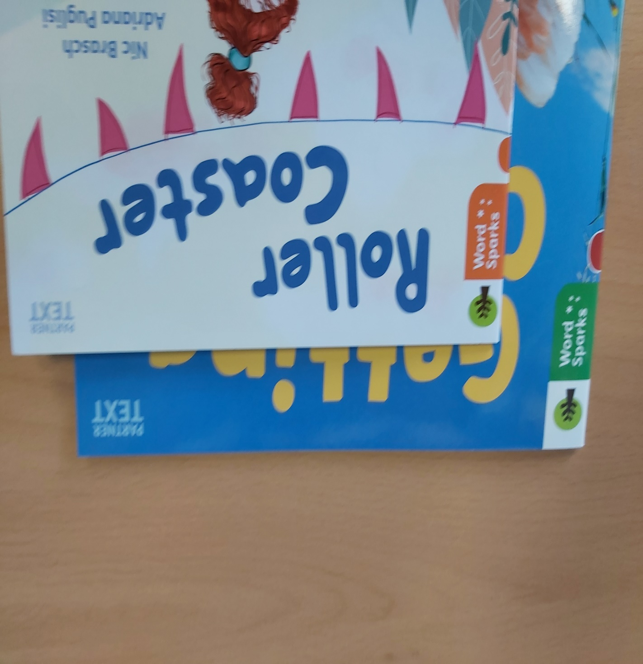
Look out for our new Word Sparks series. These are books for you to share the reading with designated adult reading pages that help to set the scene or introduce more technical vocabulary.

Slide 21
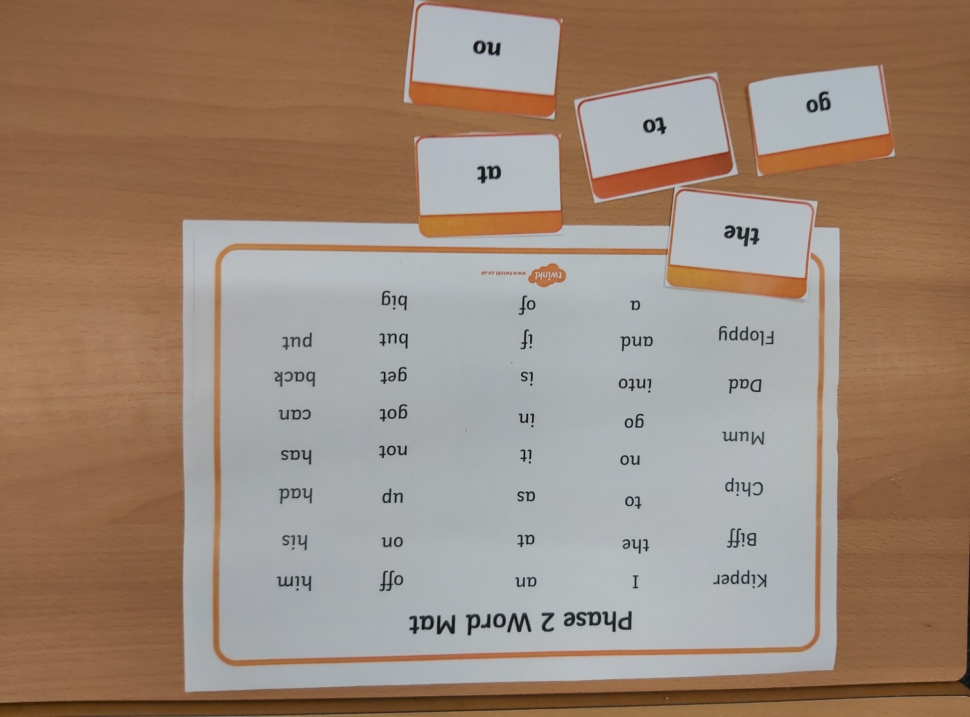
Other reading resources
Unfortunately the English language is not all phonetically spelt. There are some words that we just have to learn by sight. These words have been called High Frequency Words, Common Exception Words or tricky words. At Naunton Park we have collated these words and put them into the phonic phases matching them to when they are most likely to come across them in their reading books.
Look out for these word mats and flashcards coming home in your child’s reading wallet. Please practise these alongside the phonic sounds and before your child reads to you, especially if you know they will be coming up in their reading book.

Slide 22
Other reading resources
Year 1 Common Exception Words. All Year 1 children have a copy of this grid in the back of their yellow reading diaries. The expectation is that all Year 1 children can read and spell these words by the end of Year 1. They are not phonetically spelt and just have to be learnt as sight words. We also use this grid to help with spelling whenever we write in the classroom.
a | is | said | be | no | put
ask | has | says | he | go | push
 | his | the | me | so | pull
are |  | they | she |  | full
our |  | there | we | of | one
 | was | here |  | love | once
do | were | I | by | come | school
to | where | you | my | some | friend
today | want | your |  |  | house

Slide 23
The Screening Check
June 2022
It will be carried out by the Class Teacher.
It will be done on a 1:1 basis.
It will be carried out in a quiet space.
There will be no time limit, although if it becomes apparent that the child is having difficulty with a word, the teacher will use her judgement to move onto the next.

Slide 24
The screening check format.
The purpose of the check is to assess the child’s phonics knowledge.
The children will be asked to read 40 words
Some of the words will be nonsense or ‘alien’ words.
The remainder of the words will be ‘real’ words.
The children will be told if they are looking at a ‘real’ or ‘alien’ words.
The children will need to use their phonic knowledge to decode the words.
All of the words will be phonetic.
The words will come from any of the phonic phases including split digraphs.
Parents are informed of their child’s score in their end of year report.

Slide 25

Alien words
Look at these words, can you read them?
vox
brup
chout
sproft
blurst
If you split the words into their component sounds and blend the sounds together they can be worked out.

Slide 26
Alien words
vox = v o x
brup = b r u p
chout = ch ou t
sproft = s p r o f t
blurst = b l ur s t
This is what we are asking the children to do.

Slide 27
Look out for…
We regularly assess children on their phonic knowledge, either when we have finished teaching a phase or at the end of a term. Please look out for one of these slips in their reading diary.
We have recently assessed phase 3 phoneme knowledge.
He scored / 26.
The highlighted phonemes (sounds) are the ones he was unsure of:
j | v | w | x | y | z | zz | qu | ch | sh | th | ng | ai | ee | igh | oa | oo | ar | or | ur | ow | oi | ear | air | ure | er
Please can you practise them at home.
Thank you.

Slide 28
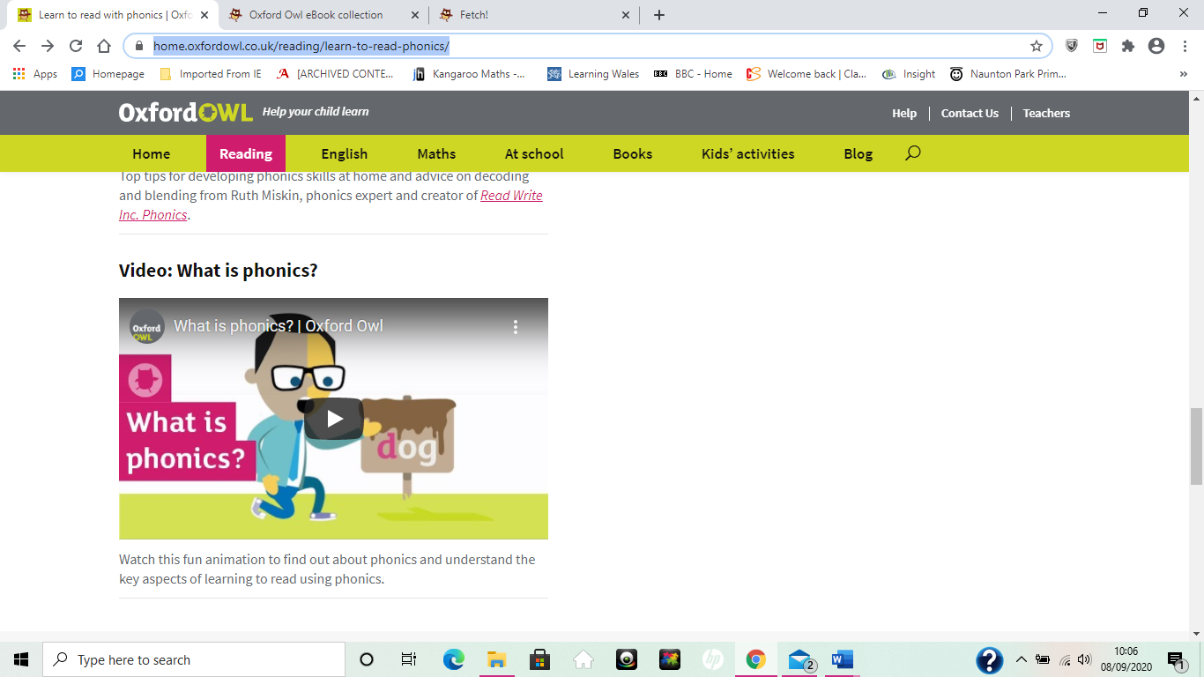
Would like to know more?
If you would like to find out a little more about phonics or would like a recap then there are some great resources and short videos on the Oxford Owl website at https://home.oxfordowl.co.uk/reading/learn-to-read-phonics/.

Slide 29
Read, Read, READ !!
Enjoy books!
Continued DAILY reading at home will maintain your child’s interest in words and will enable them to practise decoding any new words they come across.
We suggest reading sessions should last up to 10 minutes – probably less if your child is tired or reluctant.
- Practise the phonic sounds or phase sight words rather than always reading a book.

Slide 30
Some final thoughts and suggestions. .
Children do better if they’re having fun, pick a time to read when your child is in the mood.
Read a variety of material – school books, library books, fiction and non- fiction, comics, signs and labels.
Play word games such as I spy.
Have a sound of the day and think of as many words as you can with that sound in (make a family challenge if you like, see if the kids can beat the grown-ups!)
Use websites such as Phonics Play to play phonics games – many of these are free.
Apps: Teach your monster to read
      Twinkl (phase 3)

