Slide 1

PGL Residential Meeting
23rd May, 2022

Slide 2
Purpose of Residential Trips
Having fun!
Develop social skills, confidence building and independence.
Sharing and cooperating.
Understanding one another.
Accessing a wider range of activities .

Slide 3
Proposed Itinerary
Monday depart NP 2pm.
Friday arrive NP 3.15 p.m.
Children arrive at school on Monday at 8.50 a.m. and go to classroom as usual.
Labelled luggage to be left in the library. Day rucksacks to go to the classroom.
Lunch at school on Monday as usual.

Slide 4
When bus arrives!
Parents are welcome to come back to school at 2pm and wave us goodbye.
If any parents are able to take cases off of the children and help load them onto the bus, we’d be very grateful.

Slide 5
Liddington – PGL Centre
In 160 acres near Swindon.
En-suite accommodation.
Night security patrol and security gates with CCTV.
Dining room, indoor activity/entertainment areas, communal meeting areas.
Once was a hotel. Rooms are very well appointed.

Slide 6
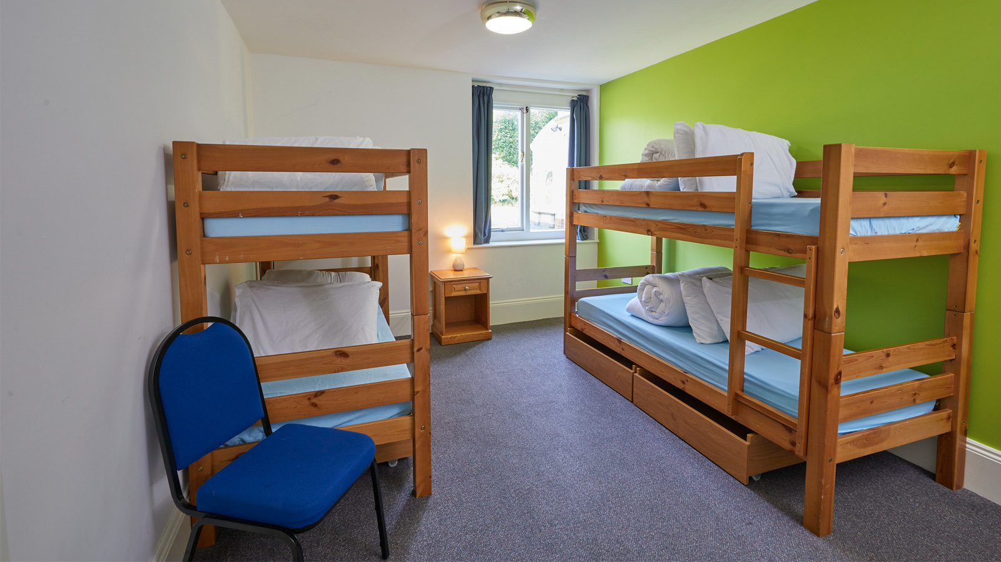

Slide 7
Liddington – PGL Centre
3 meals a day.
All dietary requirements can be catered for.
Please state dietary needs on your medical form.
Please bring your own water bottle.

Slide 8
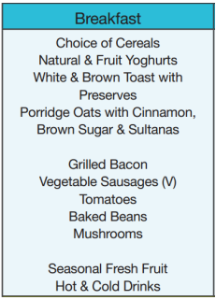

Slide 9
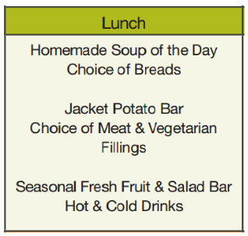

Slide 10
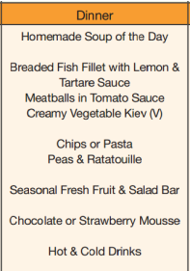

Slide 11
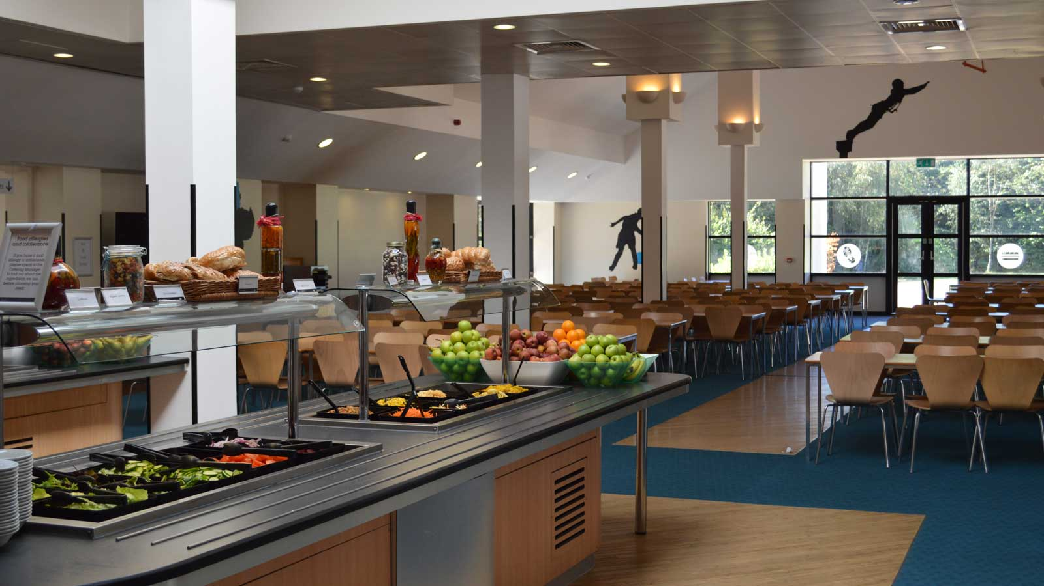

Slide 12
Activities
Examples of activities; abseiling, archery, climbing, low level ropes, zip-wire, Jacob’s ladder, high-wires, fencing, giant swing, orienteering.
All activities based at the centre.
Evening activities and entertainment included.

Slide 13
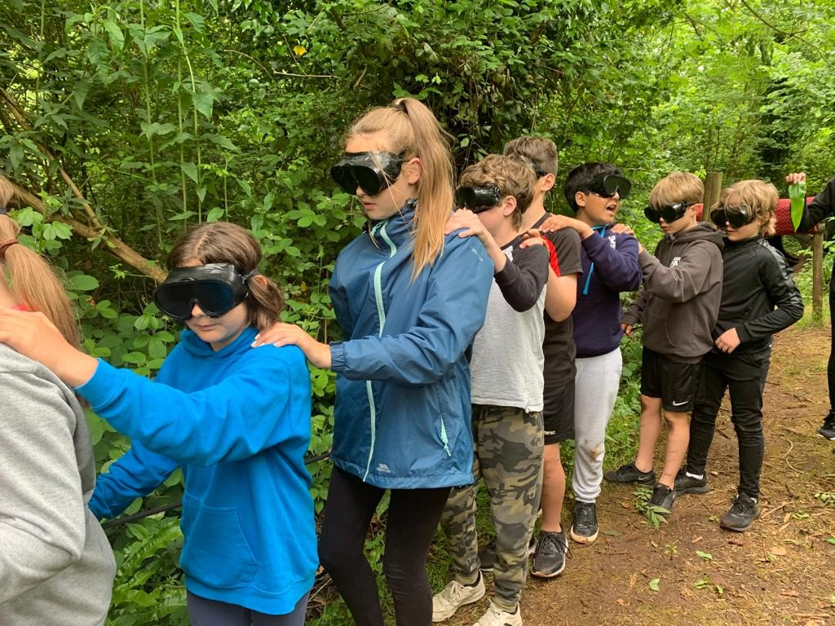
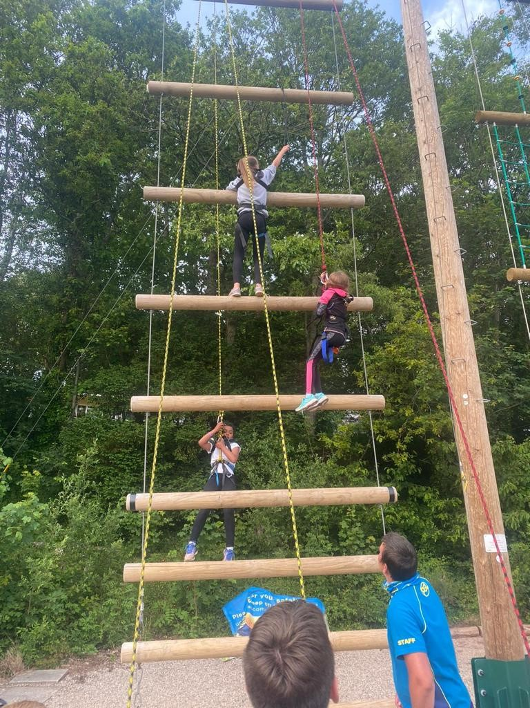

Slide 14
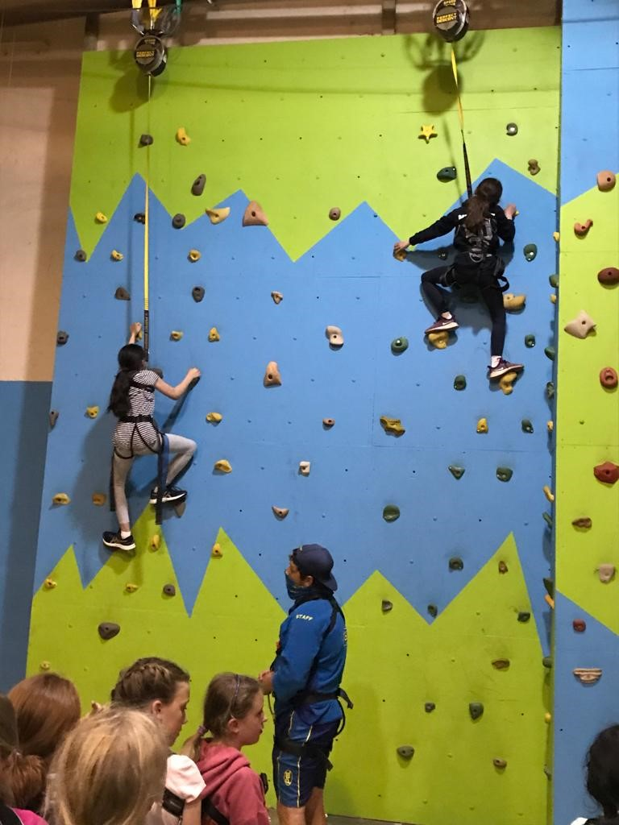
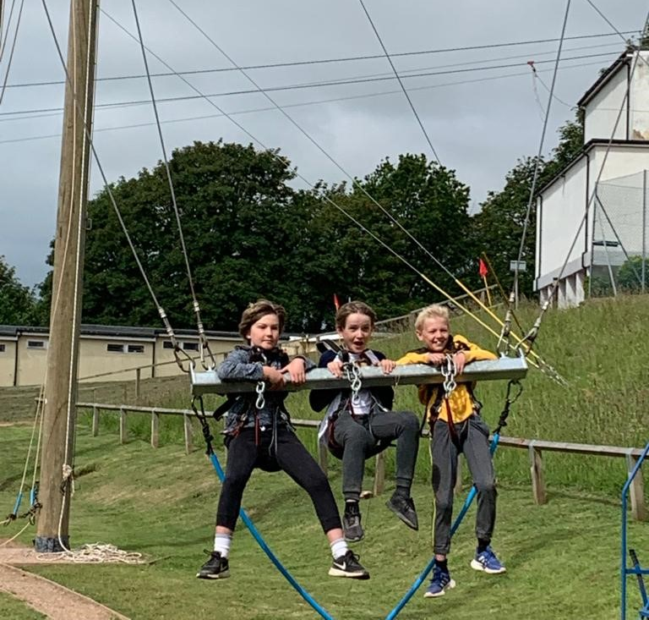

Slide 15
What to pack
Kit list will be sent as soon as we get it.
No bedding or sleeping bags required.
No torches – unless for a pre-arranged reason.
Don’t forget a day bag for a water- bottle and any personal equipment such as a camera, suntan lotion or inhaler.

Slide 16
What to pack
Children may bring a camera but are expected to look after it themselves.
May bring a book or quiet game for the journey.
Please, no iPods, tablets, radios or electronic games.
NO PHONES!
Check the forecast.
Waterproof coat is a must!

Slide 17
Medical and Social Issues
Please discuss social or medical concerns with class teachers.
Clearly labelled medicines, with dosage and administration details to Miss Garrick or Mrs Staniland, on 6th July, at the latest.
Particular issues can be overcome in a variety of ways.
Useful for children to stay away from home before the trip (if haven’t done so already).
Complete and return consent form ASAP.

Slide 18
Keeping in touch
24hr number for emergencies only.
School can contact staff.
Staff will contact parents if necessary – no news is good news!
Daily text to parents with updates.
NPPS Facebook page will be updated daily.
Children will not be allowed to phone home.

Slide 19
Safety of the Children
Full 24 hr insurance including the journey.
Full risk assessments.
Always qualified first-aiders.
School staff and qualified trained instructors at the centres.
Emergency contacts for parents and procedures in place.

Slide 20
Safety of the Children
Secure site.
Student:staff ratios higher than requirement.
Car for emergencies.
Walkie-Talkies for staff.
Staff rooms between children’s dorms.
Careful grouping and dorm groups.

Slide 21
Safety of the Children
School rules and Behaviour Policy apply throughout our trip.
  Following instructions is vital
  Listening is vital for everyone’s safety
  Respect of one another, adults, property, personal space
  Kind language
  Own dorms ONLY
  Not mixing with other schools

Slide 22
Any Questions?
We are happy to answer general questions now. If, however, your question is relating to just your own child, please come and see us in the playground, give us a ring or send an email to the office and we will be in touch

