Slide 1
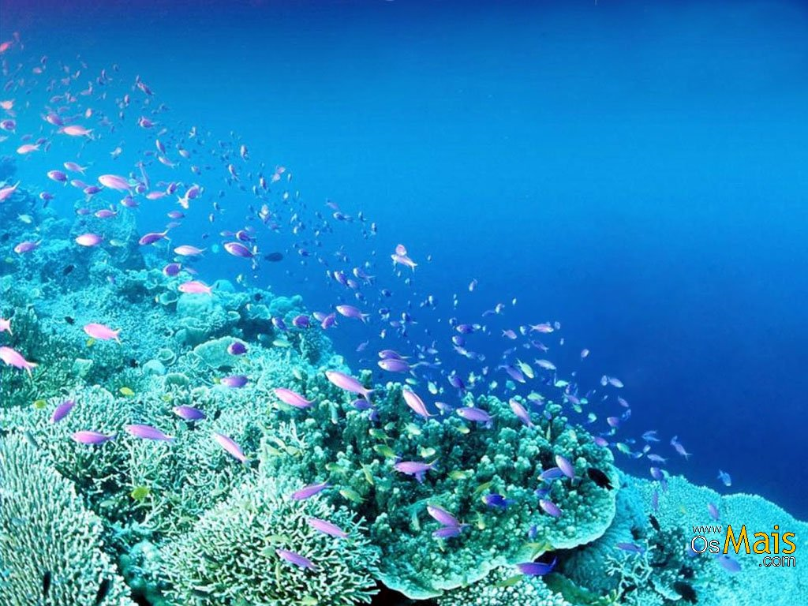
Home Learning (Years 1-6)
Summer 2 Week 1
‘Under the Sea’

Slide 2
Your Weekly Project
Hi everyone!
Here is your project for this week, ‘Under The Sea’. You will find a number of activities that you can complete across a number of subjects.
This project is for all year groups (1-6) to access so you can pick and choose which you would like to complete for each subject. You can complete activities from other year groups if you like. Please note that the tasks get progressively harder as you move down the slide. This also means that you can work with your siblings when carrying out your research. Reception class have a different project this week which can be found on the Reception Home Learning pages on our website.
Keep up the great work!

Slide 3
Y1/2 - Phonics
Sound hunt – Go on a sound hunt around the house/garden. Make a list of as many items you can find containing the ‘ea’ sound. Can you find objects with the same sound but an alternative spelling? (ey/ee)
Rhyming – Can you think of words that rhyme with ‘sea’? Make a list!
Buried treasure – Visit the Phonics Play website to play Buried Treasure. Choose the ‘ea’ sound.
https://www.phonicsplay.co.uk/BuriedTreasure2.html#

Slide 4
Spellings
Y1 – Can make a list of words you associate with the sea?
Y2 Oceans – Learn to spell the names of all the world’s oceans. Can you write these in sentences?
Y3/4 Alphabetical order – Can you think of a sea related word for every letter of the alphabet?
Y3/4 Sea words – Put the following words in alphabetical order and then use a dictionary to find the meanings of each word: marine, barnacle, crustacean, coral, mangrove and barracuda.
Y5 Word bank – Create a vocabulary bank about life under the sea which includes verbs, adverbs, expanded noun phrases and relative clauses.
Y5/6 Glossary- Create a glossary for these sea-related words: estuary, algae, plankton, tsunami, urchin. Can you draw an illustration to represent each word?
Y6 Proofreading – Get a dictionary and proofread your writing from this week. What did you find tricky? What could you improve on?

Slide 5
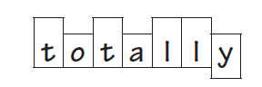
Spellings
Common exception words or 100/22 High Frequency Words – Use the word banks on the following slides to practise your common exception words and/or your 100/200 High Frequency words. You might find it helpful to use some of the following strategies.
Look, cover, write, check
Segmenting – Split the word into sounds in the correct order and then spell out each sound.
‘Quickwrite’ – Writing the word correctly as many times as you can in any given time frame.
Draw around the word – Get to know the shape of the word.

Slide 6
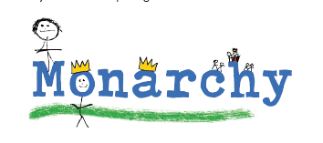
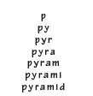
Spellings
Rainbow writing – Use a different colour to make tricky sounds memorable.
Drawing an image around the word – Make the word more memorable by drawing pictures that make the spelling noticeable.
Pyramid words – This method forces you to
think of each letter separately.

Slide 7
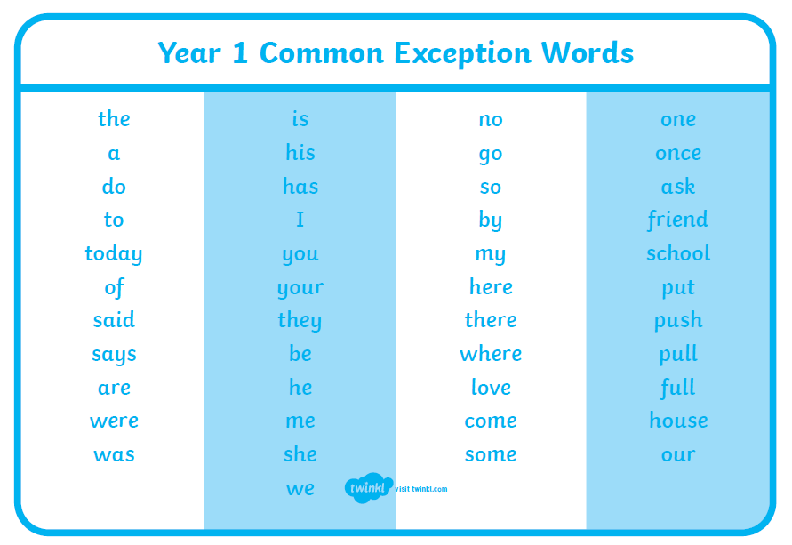

Slide 8
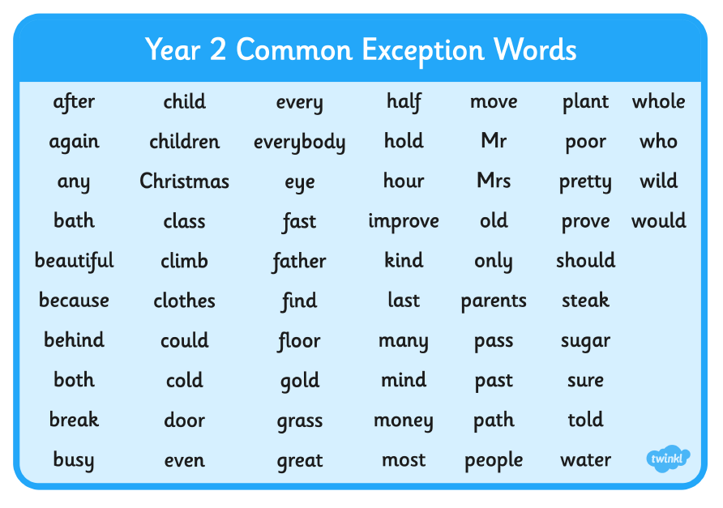

Slide 9
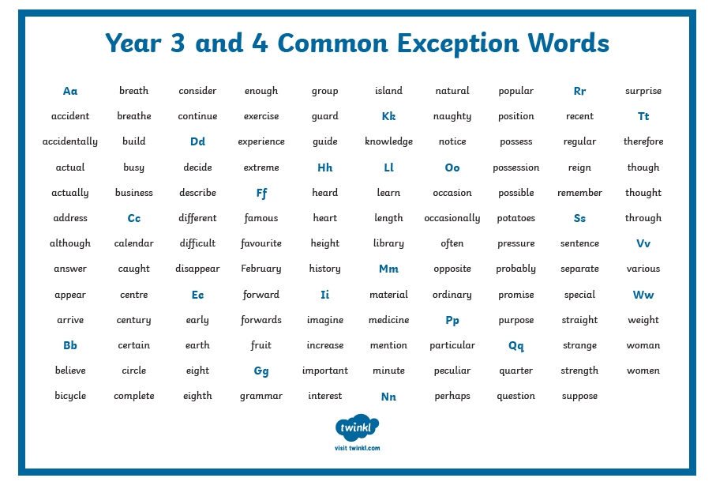

Slide 10
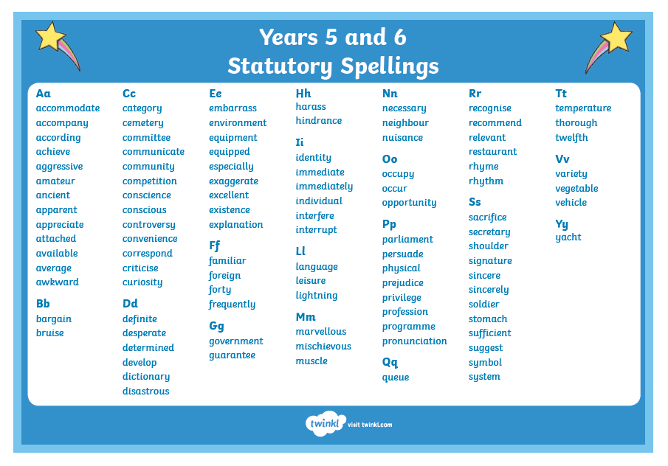

Slide 11
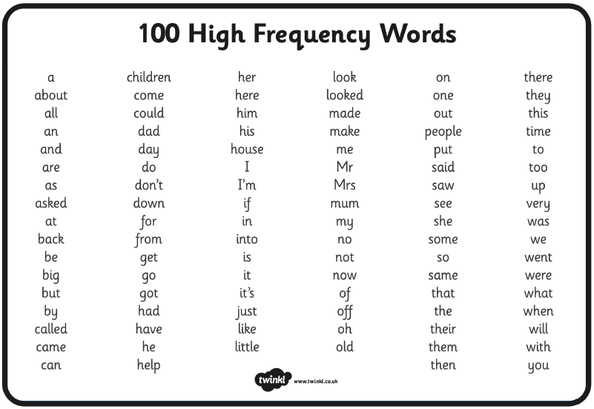
100 High Frequency Word List

Slide 12
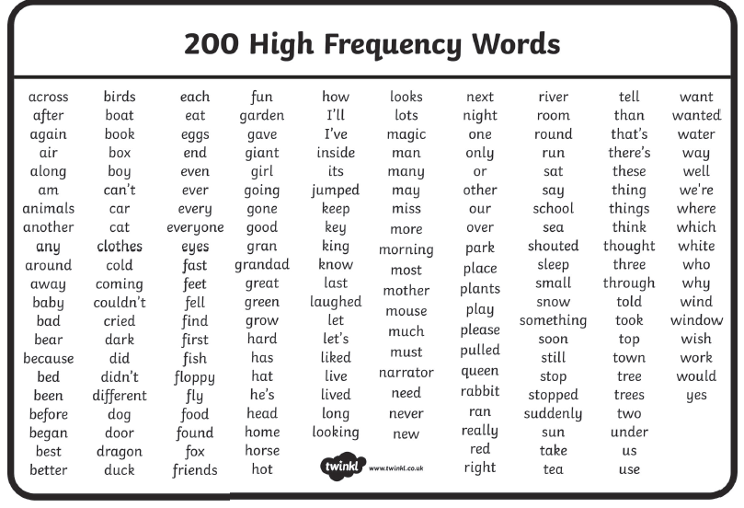
200 High Frequency Word List

Slide 13
Writing
Can you plan for a trip to the beach? Write a list of the things you will need to pack.
Create a fact file for a sea creature of your choice. Can you include information about its appearance, diet and habitat?
Imagine you are a deep sea diver. Can you write a detailed description about the ocean and include specific species? Include adjectives.
Write an advert for someone to apply for a job to work on a submarine. Is your advert persuasive?
If you were a sea creature, what would you wish to do? Compose and perform your poem.
Write/type an information report about one of the world’s oceans or a sea creature of your choice. Remember to include: subheadings, pictures and interesting facts.
Write a sea adventure story. Try to include dialogue, conjunctions, and a range of vocabulary and openers.

Slide 14
Writing
For the tasks below, first watch this clip called the ‘The Lighthouse’:
https://www.literacyshed.com/the-lighthouse.html (Remember you only need to choose one of these activities and they get more challenging as you move down the list. You may, however, choose to do them all!)
- Create a beach safety poster.
Write an ‘under the sea’ rhyming poem.
Create a diary entry based on the life of a deep sea diver.

Slide 15
Reading (Year 1/2)
Term 6’s Reading Challenge – see link on our website’s Home Learning pages
Rhyme time! – Learn and recite the rhyme ‘A Sailor went to Sea, Sea, Sea.’
https://safeyoutube.net/w/Msh6
Reading den – Build an ‘Under the Sea’ themed reading den. Can you find some sea-themed books to cosy up with and share in there?
Bookmark – Can you make a sea-themed bookmark?
Bedtime story – Can you read a poem, story or nursery rhyme to another family member before bed? You might even like to Facetime another family member.
Story time – Read along with ‘There’s a Hole in the Bottom of the Sea’ or listen to ‘How the Whale got his Throat’. Can you retell one of these stories or draw a comic strip of events?
https://www.booktrust.org.uk/books-and-reading/have-some-fun/storybooks-and-games/A-hole-in-the-bottom-of-the-sea/
https://www.storynory.com/how-the-whale-got-his-throat/

Slide 16
Reading (Year 3/4)
Term 6’s Reading Challenge – see link on our website’s Home Learning pages
Expression – Read to a family member and really focus on your expression.
Summarise – Write a book review for your favourite book and write a summary of what you have read.
Research – Research and read about an ocean creature of your choice. Here are some interesting facts about Turtles to get you started.
https://www.natgeokids.com/uk/discover/animals/sea-life/turtle-facts/
Poetry – Listen and read along with two of the poems in the Under the sea collection. Compare the different uses of language in each one.
https://childrens.poetryarchive.org/collections/under-the-sea/
Word meaning - Read an extract from Ocean Emporium. Use a dictionary to clarify any unfamiliar vocabulary.
https://www.lovereading4kids.co.uk/extract/15536/Ocean-Emporium-by-Susie-Brooks.html (copy and paste this link into Chrome – clicking on it won’t work for some reason!)

Slide 17
Reading (Year 5/6)
Term 6’s Reading Challenge – see link on our website’s Home Learning pages
Read, read, read! – Time to read your favourite book. Why not listen to these sea noises while your read?
https://safeyoutube.net/w/cPB6
Quiz time – Create a true or false quiz based on a book you read recently. Can you test it on someone who has also read the book?
The Mermaid’s Lament – Listen and read along with the Mermaid’s Lament. Find a glossary in the Teach section and see if you can identify some of the terms used in the poem, for example rhyme and personification.
https://childrens.poetryarchive.org/poem/mermaids-lament/
First News – Read First News. Can you find the following: good news, bad news, reference to a famous politician, a story about a popstar and the name of a city or country. Have another go with a different newspaper or magazine.
https://subscribe.firstnews.co.uk/free-downloadable-issue/

Slide 18
Maths
Please use the links below to find your Maths Lessons for this week along with the linked activities/worksheets. COPY AND PASTE the links into Chrome – the hyperlinks don’t work ☹
Year 1 - Length and mass (Lessons 1 – 5)
https://www.thenational.academy/online-classroom/year-1/maths#
Year 2 - Face, shape and pattern (Lessons 1 – 5)
https://www.thenational.academy/online-classroom/year-2/maths#subjects
Year 3 - Fractions (Lessons 1 – 5)
https://www.thenational.academy/online-classroom/year-3/maths#subjects
Year 4 - Area and Perimeter (Lessons 1 – 5)
https://www.thenational.academy/online-classroom/year-4/maths#subjects
Year 5 - Transformations (Lessons 1 – 5)
https://www.thenational.academy/online-classroom/year-5/maths#subjects
Year 6 - Fractions (Lessons 1 – 5)
https://www.thenational.academy/online-classroom/year-6/maths#subjects

Slide 19
Science
Guess who? – Write facts cards about animals from under the sea. Use books and websites to find out about the appearance, habitat and diet of each creature. After, play ‘Guess who?’ using the cards and yes/no questions.
Explore the Blue Abyss – Can your child remember oceans from around the world? Can you investigate the five different layers of the ocean (Sunlight zone, Twilight zone, Midnight zone, Lower midnight zone, or Abyss and the trenches) ? Sea creatures live in different layers and adapt to these. Can you investigate what creatures are found in each layer and create a fact file or labelled diagram?
Bioluminescence: Lighting up our Oceans – Many sea creatures possess a fascinating light-producing ability called Bioluminescence. Some fish dangle a lighted lure in front of their mouths to attract prey, while some squid shoot out Bioluminescent liquid, instead of ink, to confuse their predators. Use the link to find out about Bioluminescence and how some creatures rely on this for survival. Create a fact file or poster all about Bioluminescence.
https://safeyoutube.net/w/vLB6

Slide 20
PE
Under the Sea Stretches – Have a go at some yoga using Cosmic Kids. There are lots of ‘Under the sea’ yoga workouts and even a Moana-themed adventure.
https://safeyoutube.net/w/Otw6
Speeding through the seas – Sailfish are the fastest fish in the ocean. Complete the following activities as fast as you can: star jumps, tuck jumps, press-ups, squats and lunges. How many repetitions of each activity can you perform in 1 minute? Can you beat your personal best? Record your heart rate (beats per minute) after each activity.
The Daily 10 – Y3, Y4, Y5 and Y6 are were doing this in school 2x per week, but everyone can get involved in doing The Daily 10 by running, jogging, skipping, roller-booting or scooting for 10 minutes each day.

Slide 21
Computing
Presentation - Use PowerPoint to create a presentation of your science, geography or history work.
Documentary - Use iMovie or a similar program to record yourself making a documentary about sea creatures. You could ask an adult if you can download ‘Do Ink’ a green screen app which will let you put different backgrounds behind you.
Scratch Coding – Go to https://scratch.mit.edu/projects/editor to use the Scratch program to make a game where two sea creatures chase each other; have to navigate an underwater maze; or have to dodge an attacker.

Slide 22
Geography
Oceans of the world – Using an atlas or the web ask your child to identify the world oceans. Can you investigate what animals live in each ocean? Use the link to practise naming and locating the oceans.
http://www.sheppardsoftware.com/World_Continents.htm
How do humans affect the sea? – Is your child aware of all the ways that humans affect the sea and the living things within it? Talk about and investigate the impact that humans are having on the sea. Create a poster or information report.
Reef research – The Great Barrier Reef is the only living thing which is visible from space! Encourage your child to take a virtual tour using the link below. Create a poster or video to promote the Great Barrier Reef. Use scientific language relating to the habitats and species groups found in the reef.
https://www.airpano.com/360photo/Great-Barrier-Reef-Australia/

Slide 23
Geography
Plastic Diary – Blue Planet 2 sparked outcry about the health of our oceans and the huge threat caused by plastics, but lots of people around the world are working hard to help solve this problem. Learn about Madison Edwards, a 12 year old environmental activist. How could you preserve our oceans? Keep a ‘plastics diary’ recording how much single-use plastic your family uses.

Slide 24
History
Grace Darling – Grace Darling was the daughter of a Lighthouse Keeper. But why did she become so famous? What can you find out about Grace Darling? Create a fact file/information text about her life.
https://www.bbc.co.uk/teach/class-clips-video/true-stories-grace-darling/z4y7pg8
Figures of History or Brutal Sea-Thieves? – Many books have been written and movies made about pirates. But who were the real pirates of the past? Using the link below explore facts about real pirates from history. Create a fact file or information report about anything you have learned, including key dates and figures. Alternatively you could create a wanted poster for a pirate, including facts about his/her deeds and adventures.
https://www.dkfindout.com/uk/history/pirates/

Slide 25
Art
Put your goggles on: Watch this live stream of a tropical reef (COPY AND PASTE this link into Chrome) https://explore.org/livecams/under-the-water/pacific-aquarium-tropical-reef-camera Whilst watching, sketch all of the animals that you can see. Look carefully at the shapes and patterns on each creature.
Lighthouse: Have a go at drawing a lighthouse with sea surrounding it. Is it a calm, tranquil sea? Or perhaps an angry, raging sea?
Artwork to light up your life: Following on from your Science work on Bioluminescence, you can create a Bioluminescent sea creature inspired piece of art. Use bright colours to paint or draw a creature, trying to make this as realistic as possible!

Slide 26
DT
Junk Modelling – Using junk or recycling materials from around your home, design and make a sea creature.
Submarine Sculptures – Look at pictures of real life submarines and create your own model submarine from different materials found at home. E.g. plastic bottles, paint, coloured pencils, string, paper etc. Talk about the suitability of each material.
Boat sculpture – Use junk from around your house to create a boat. Will it carry a load?

Slide 27
RE
Story Focus: ‘The Creation Story’
Explore what Christians believe about how the world was created. Can you re-tell The Creation Story?
Investigate ways that people can look after the world and why it is important for everyone. How should we care for the natural world and for others, and why does it matter? How else can we care for others? List your ideas.
Can you compare this to beliefs about creation from another faith? (eg. Hinduism, Sikhism, Islam) How are they similar/different? Make a record of comparisons.
How are religious organisations helping to care for the world? Create a poster about a religious organisation/charity of your choice.

Slide 28
Music
Sea Music - Listen to the pieces of music inspired by the sea:
https://www.bbc.co.uk/programmes/articles/3Fm3H66YnxNZslLrSX3mMvh/top-six-sea-pieces
How did the pieces make you feel? Which instruments did they use? Are the pieces successful in communicating the different moods of the sea? eg. calm, rushed, raging
Fisherman’s Friends - You can also enjoy listening to the famous Cornish Fisherman's Friends singing a sea shanty - https://www.youtube.com/watch?v=sJ82Jhf5cHI&list=OLAK5uy_k4PUoQcpdkD7xc_o1KrwALmAI1VTugD8c
Sea shanties are traditional songs which are sung in fishing communities. See if you can find out about the origins of sea shanties and why they are still sung today.

