Slide 1
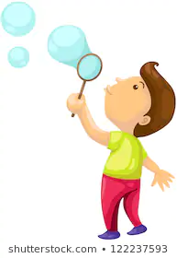
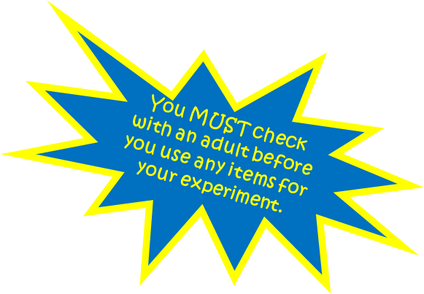
Best Bubbles!
Instructions:
Pour water into a bowl.
Gently stir in dishwashing liquid.
Make an “O” shape using forefinger and thumb (or you could use a piece of wire).
Blow.
Investigate:
What happens?
Why?
Can you alter the make up of the liquid to make larger bubbles?
You need to research and decide on the best recipe.
You can decide what you would like to change.
Make sure that you work scientifically.

Slide 2
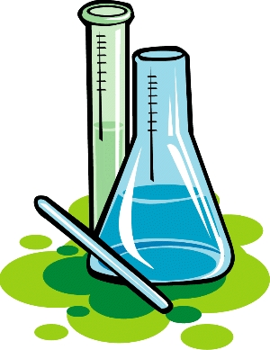

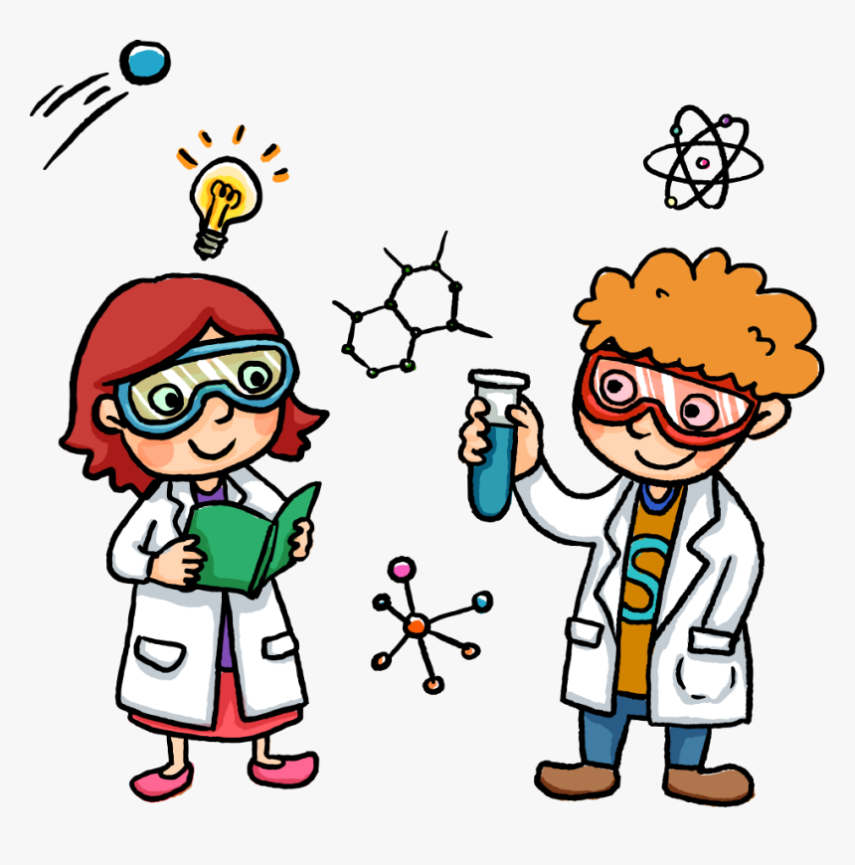
Year 6 Challenge!
Investigate the best bubble recipe.
Task:
Design, carry out and write up an experiment to find the best recipe for bubbles.
Writing up
Use the headings below and remember to include lots of detail and scientific vocabulary to explain your ideas.
Question
Method
Prediction
Results
Conclusion
What are you going to find out? Be precise.
Instructions that explain exactly how to do your experiment. How will you set this out?
What do you think the answer to your question will be? What previous knowledge makes you think that?
How will you show you results? How will you make sure they are clear and easy to read?
POINT – Answer your question
EVIDENCE – What do your results tell you?
EXPLAIN – Explain your results using scientific vocabulary.
LINK – How do you know your evidence is reliable?
You MUST check with an adult before you use any items for your experiment.

